Slide 1
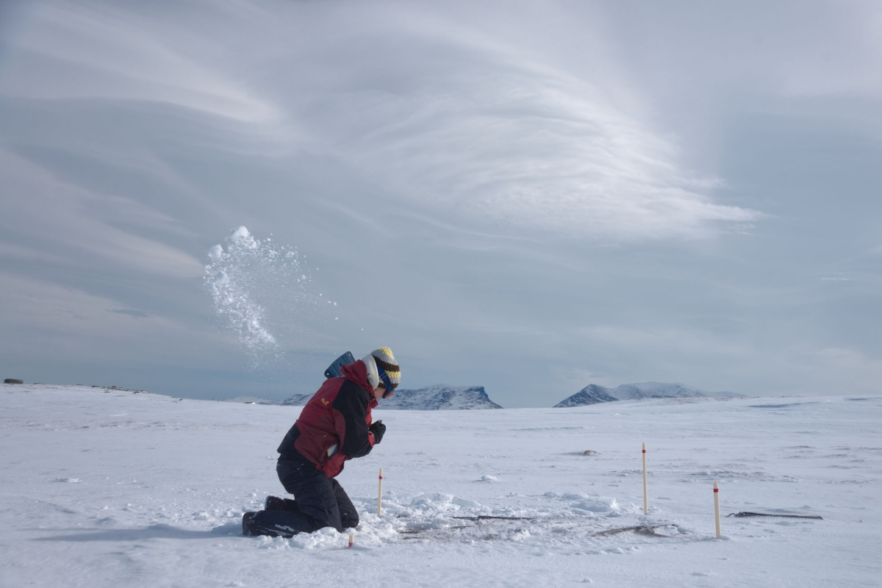
A Century of Arctic Climate Change: An Abisko Perspective
Keith Larson, PhD
Climate Impacts Research Centre
Umeå University
Updated: 9 December 2019
Notes:
Winter title slide

Slide 2
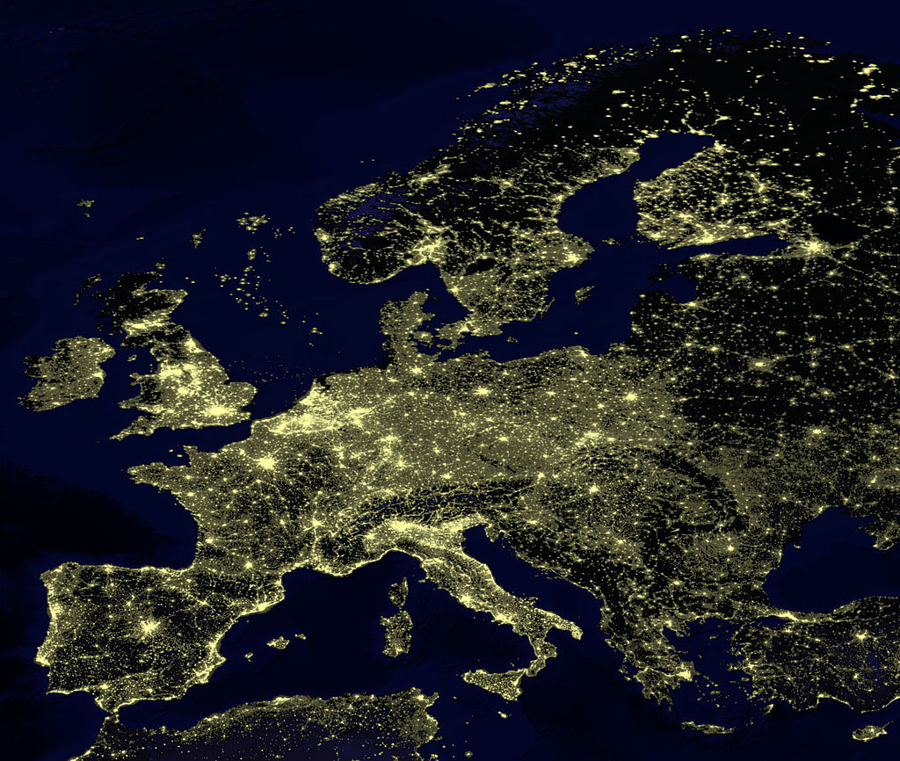
200 km north of the Arctic Circle
Abisko
Notes:
Map taken from: https://brilliantmaps.com/europe-at-night/

Slide 3
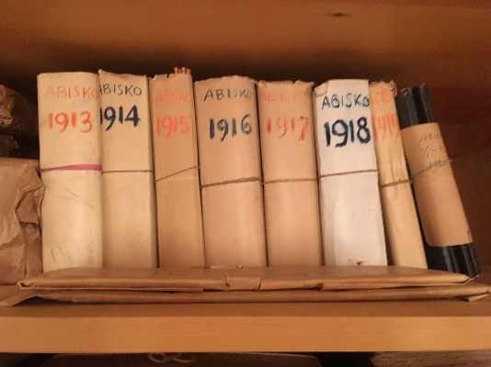
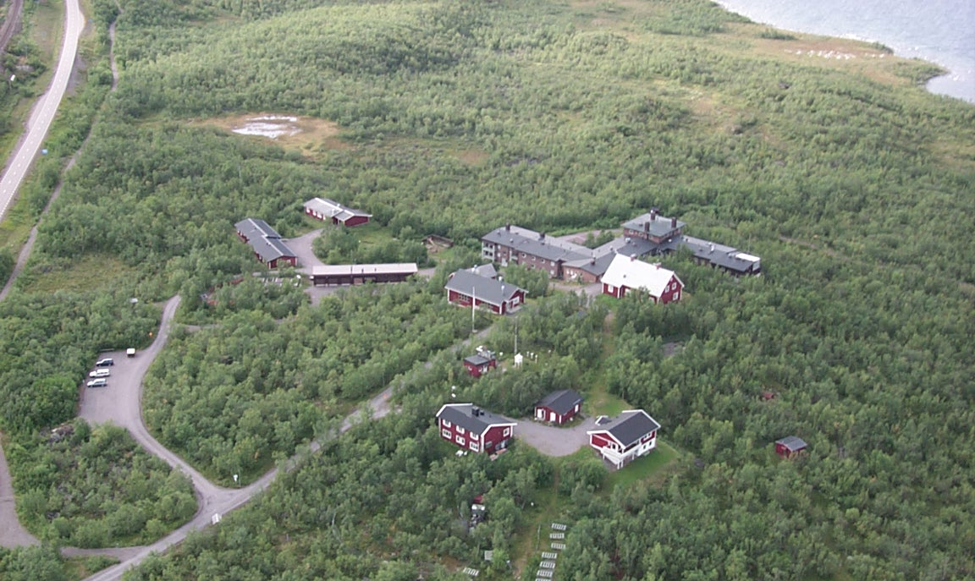
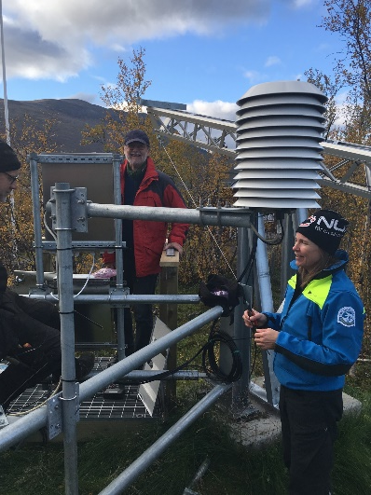
Abisko Scientific Research Station
Unique environmental record-meteorological monitoring (1913 to present)
Observatory
Aerial Photo: Nils Åke Andersson, others by Keith Larson
Notes:
Photo taken by Nils Åke Andersson
The new station was built in June 1912 and opened in 1913 (B-House). Cost 20 000 SEK. Originally permitted to be built in the national park.
Meteorological monitoring and natural science research started in 1913. The station now holds a unique environmental record that extends 100 years back in time, as well as a vast portfolio of research activities totaling some 3,000 scientific publications.
The station’s long term records consist of many environmental variables such as climate, snow depth, ice thickness and ice duration on Torneträsk. The monitoring also includes hydrology, water chemistry, flora and fauna, as well as phenology, geomagnetism and atmospheric carbon isotope composition.

Slide 4
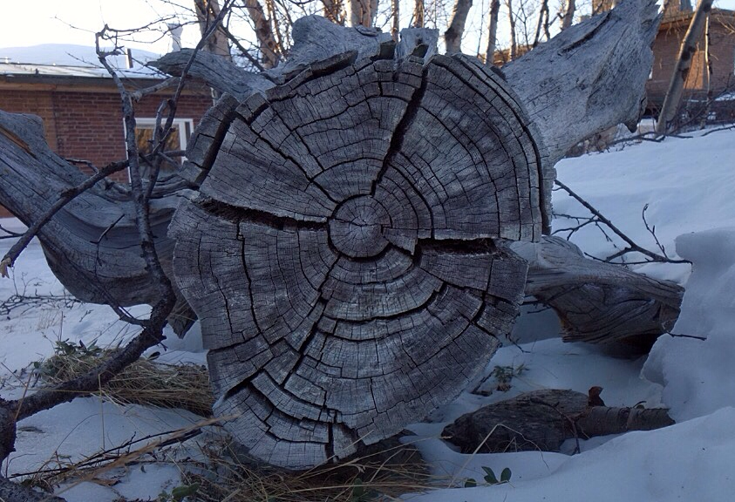
How do we know about the past climate before we built weather stations?
Photo: Scott Wilson

Slide 5
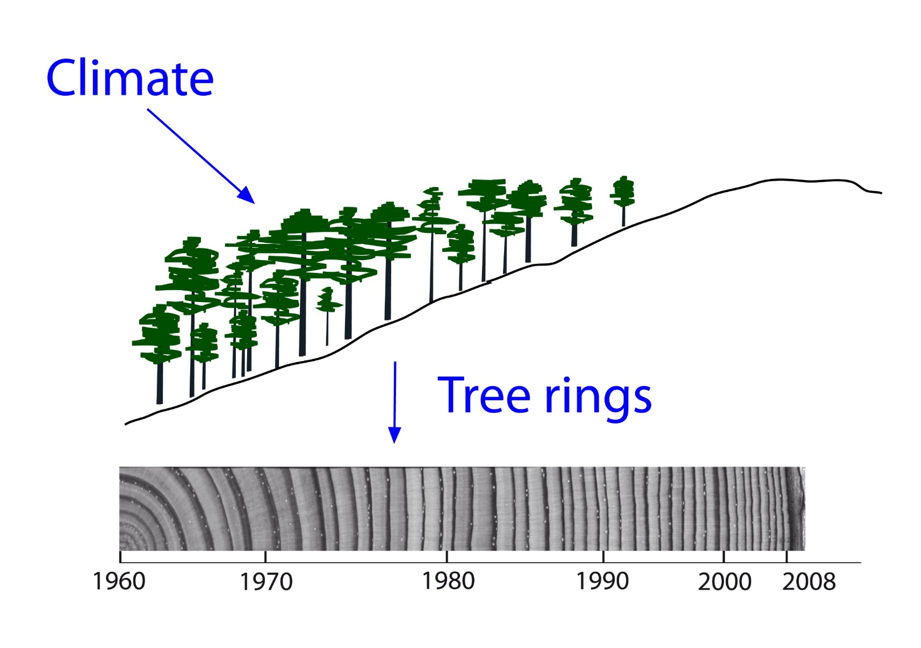
Weather and climate is written is wood
Photo: Håkan Grudd

Slide 6
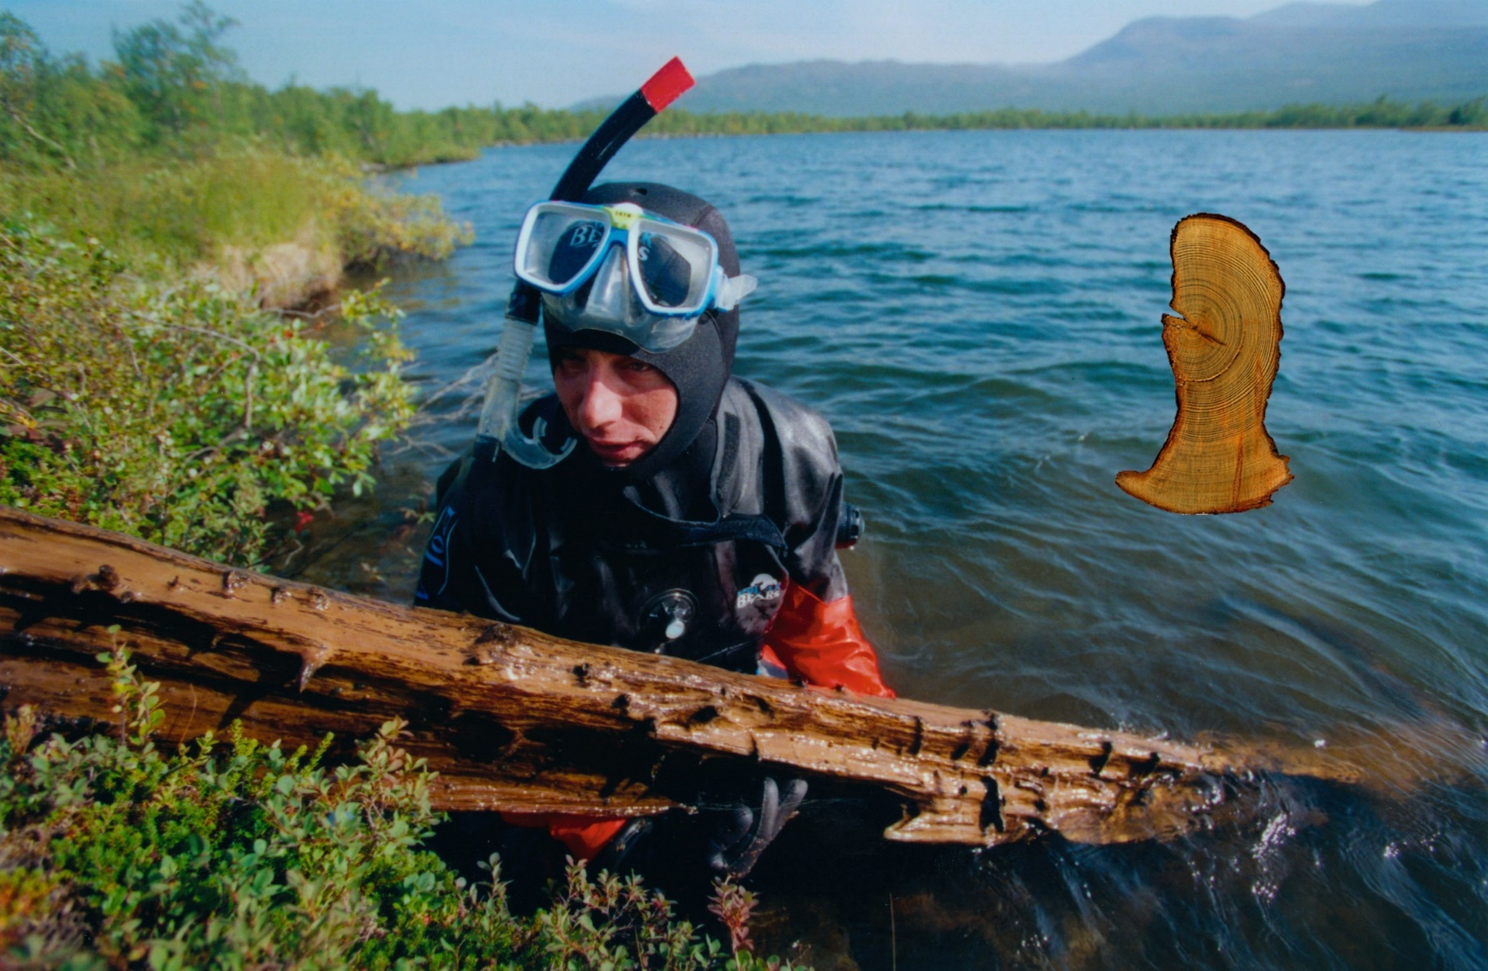
How far back can we go?
7000
Years old!
Photo: Håkan Grudd

Slide 7
Abisko long-term climate regimes
§
Medieval Warm Period (c. 950 to 1200)
Global warming (c. 1900 to present)
Marine Air Dominate
Arctic Air Dominate
Little Ice Age (c. 1200 to 1900)
No evidence for globally coherent warm and cold periods during the preindustrial era
Loader et al. 2013, Neukom et al. 2019
Notes:
Figure taken from:
Loader, N. J., Young, G. H. F., Grudd, H., McCarroll, D. (2013). "Stable carbon isotopes from Torneträsk northern Sweden provide a millennial length reconstruction of summer sunshine and its relationship to Arctic circulation." Quaternary Science Reviews 62: 97-113.
Also see:
Grudd, H., K. R. Briffa, W. Karlén, T. S. Bartholin, P. D. Jones, and B. Kromer. 2002. A 7400-year tree-ring chronology in northern Swedish Lapland: natural climatic variability expressed on annual to millennial timescales. The Holocene 12:657–665.
Further reading:
Neukom, R., N. Steiger, J. J. Gómez-Navarro, J. Wang, and J. P. Werner. 2019. No evidence for globally coherent warm and cold periods over the preindustrial Common Era. Nature 571:550–554.
Medieval Warming Period (https://en.wikipedia.org/wiki/Medieval_Warm_Period)
Little Ice Age (https://en.wikipedia.org/wiki/Little_Ice_Age)

Slide 8
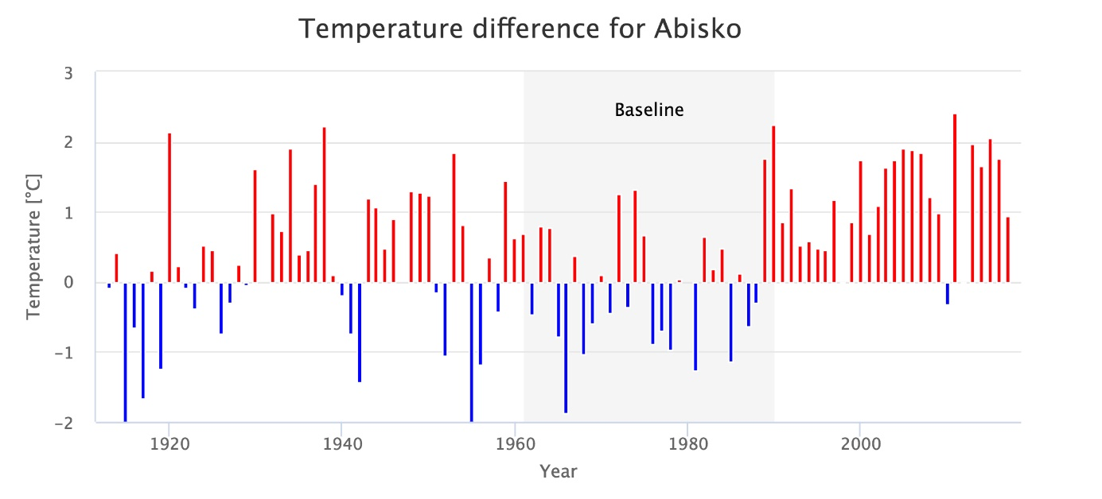
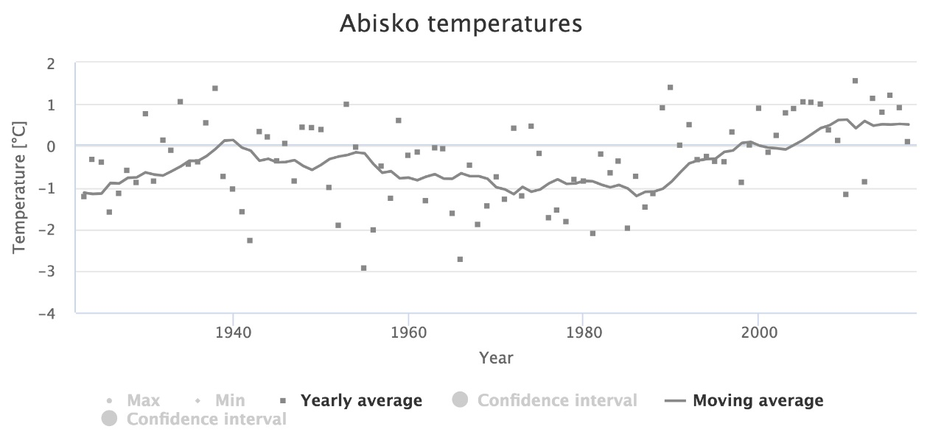
Arctic warming
1989
Abisko temperatures have risen 1.7°C since 1913
ANS (unpublished data 2018)
Notes:
Data from ANS (unpublished 2018)
Why use temperature differences or anomaly plots to describe patterns and trends?
“The term temperature anomaly (or difference) means a departure from a reference value or long-term average. A positive anomaly indicates that the observed temperature was warmer than the reference value, while a negative anomaly indicates that the observed temperature was cooler than the reference value.”
https://www.ncdc.noaa.gov/monitoring-references/faq/anomalies.php
“In climate change studies, temperature anomalies are more important than absolute temperature. A temperature anomaly is the difference from an average, or baseline, temperature. The baseline temperature is typically computed by averaging 30 or more years of temperature data. A positive anomaly indicates the observed temperature was warmer than the baseline, while a negative anomaly indicates the observed temperature was cooler than the baseline. When calculating an average of absolute temperatures, things like station location or elevation will have an effect on the data (ex. higher elevations tend to be cooler than lower elevations and urban areas tend to be warmer than rural areas). However, when looking at anomalies, those factors are less critical. For example, a summer month over an area may be cooler than average, both at a mountain top and in a nearby valley, but the absolute temperatures will be quite different at the two locations.
Using anomalies also helps minimize problems when stations are added, removed, or missing from the monitoring network. The above diagram shows absolute temperatures (lines) for five neighboring stations, with the 2008 anomalies as symbols. Notice how all of the anomalies fit into a tiny range when compared to the absolute temperatures. Even if one station were removed from the record, the average anomaly would not change significantly, but the overall average temperature could change significantly depending on which station dropped out of the record. For example, if the coolest station (Mt. Mitchell) were removed from the record, the average absolute temperature would become significantly warmer. However, because its anomaly is similar to the neighboring stations, the average anomaly would change much less.” https://www.ncdc.noaa.gov/monitoring-references/dyk/anomalies-vs-temperature
What is a baseline and why use it?
“A climate change scenario is defined with respect to a climatological baseline, which determines a reference point for the projected climate changes. Climate scenarios that are developed for impacts applications usually require that some estimate of climate change be combined with baseline observational climate data. Thus, the demand for more complete and sophisticated observational data sets of climate has grown in recent years. The important considerations for the baseline include the time period adopted as well as the spatial and temporal resolution of the baseline data. IPCC have usually taken the year '1990' as the baseline year for the presentation of emissions scenarios and for calculations of future climate and sea-level change. '1990' has also been adopted by the United Nations Framework Convention on Climate Change (UNFCCC) in their definition of emissions reductions targets. Choosing a single year as a baseline is appropriate for some applications, but not for climate change studies. Due to climate variability a single year may be unusually warm, cold, dry or wet and thus will not make a useful reference point for measuring climate change. It is more common to use the average climate over a 30-year period to define the baseline climate. A 30-year climatic average smoothes out many of the year-to-year variations in the climate. In addition, the individual 30 years of such a period captures much of the interannual and short time-scale variability of climate that may be relevant for an impact application. The IPCC Data Distribution Centre (IPCC DDC) suggests the period 1961-90 to be used as the baseline period. This period has generally good observed data and it represents the recent climate to which many present-day human or natural systems are likely to be reasonably well adapted. The period also ends in 1990, the year adopted by many IPCC and UN FCCC applications.” https://www.igi-global.com/dictionary/climate-change-impact-on-the-water-resources-of-the-limpopo-basin/61469

Slide 9
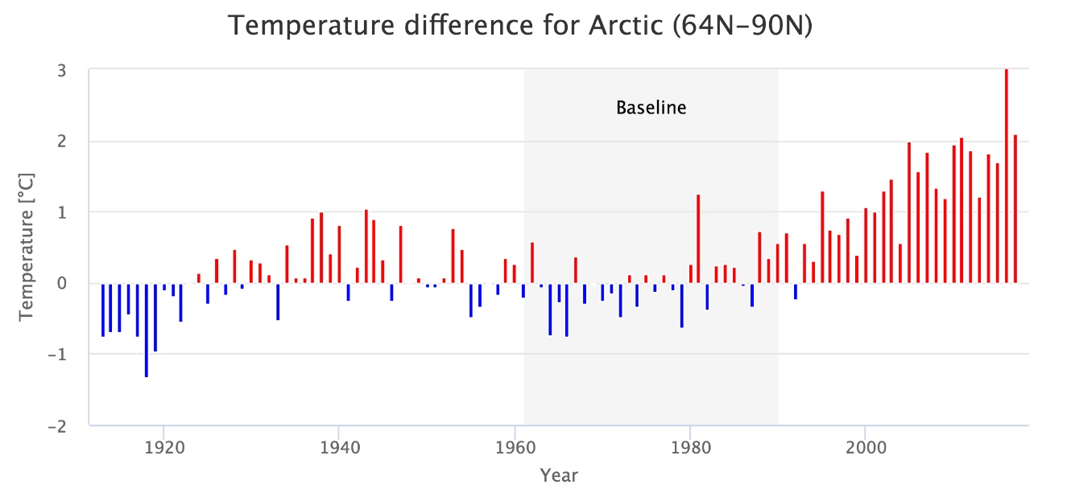
Arctic Warming
1986
ANS (unpublished data 2018); GISTEMP (v4, 2018)
Notes:
Data from ANS (unpublished data 2018) and NASA GISSTemp (2018; https://data.giss.nasa.gov/gistemp/)
Why use temperature differences or anomaly plots to describe patterns and trends?
“Absolute estimates of global average surface temperature are difficult to compile for several reasons. Some regions have few temperature measurement stations (e.g., the Sahara Desert) and interpolation must be made over large, data-sparse regions. In mountainous areas, most observations come from the inhabited valleys, so the effect of elevation on a region's average temperature must be considered as well. For example, a summer month over an area may be cooler than average, both at a mountain top and in a nearby valley, but the absolute temperatures will be quite different at the two locations. The use of anomalies in this case will show that temperatures for both locations were below average.
Using reference values computed on smaller [more local] scales over the same time period establishes a baseline from which anomalies are calculated. This effectively normalizes the data so they can be compared and combined to more accurately represent temperature patterns with respect to what is normal for different places within a region.
For these reasons, large-area summaries incorporate anomalies, not the temperature itself. Anomalies more accurately describe climate variability over larger areas than absolute temperatures do, and they give a frame of reference that allows more meaningful comparisons between locations and more accurate calculations of temperature trends.” https://www.ncdc.noaa.gov/monitoring-references/faq/anomalies.php
References for GISTEMP data:
GISTEMP Team, 2019: GISS Surface Temperature Analysis (GISTEMP), version 4. NASA Goddard Institute for Space Studies. Dataset accessed 20YY-MM-DD at https://data.giss.nasa.gov/gistemp/.
Lenssen, N., G. Schmidt, J. Hansen, M. Menne,A. Persin,R. Ruedy, and D. Zyss, 2019: Improvements in the GISTEMP uncertainty model. J. Geophys. Res. Atmos., 124, no. 12, 6307-6326, doi:10.1029/2018JD029522.

Slide 10
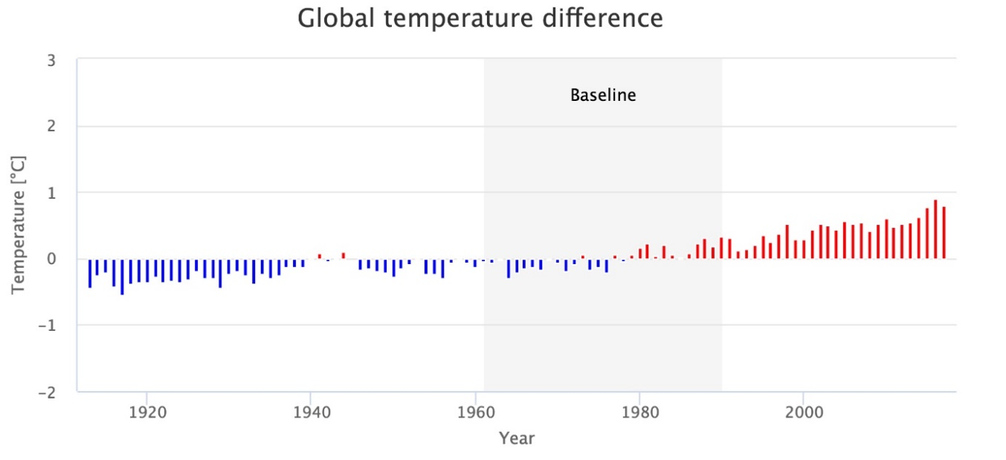
Arctic amplification
Arctic temperatures are rising at twice the global rate
ANS (unpublished data 2018); GISTEMP (v4, 2018)
Notes:
Data from ANS (unpublished data 2018) and NASA GISSTemp (2018; https://data.giss.nasa.gov/gistemp/)
References for GISTEMP data:
GISTEMP Team, 2019: GISS Surface Temperature Analysis (GISTEMP), version 4. NASA Goddard Institute for Space Studies. Dataset accessed 20YY-MM-DD at https://data.giss.nasa.gov/gistemp/.
Lenssen, N., G. Schmidt, J. Hansen, M. Menne,A. Persin,R. Ruedy, and D. Zyss, 2019: Improvements in the GISTEMP uncertainty model. J. Geophys. Res. Atmos., 124, no. 12, 6307-6326, doi:10.1029/2018JD029522.

Slide 11
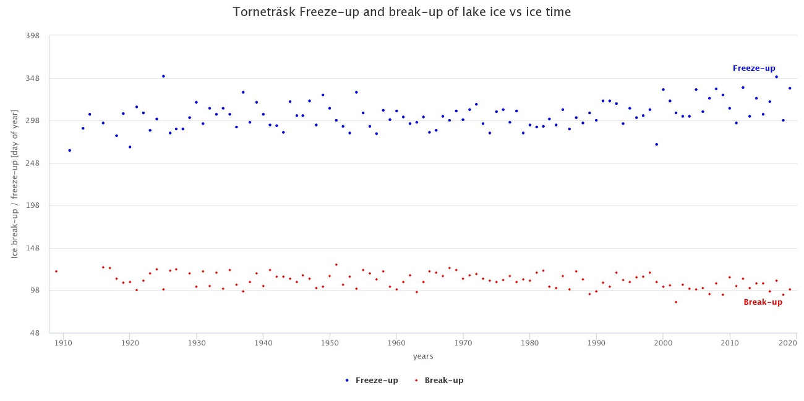
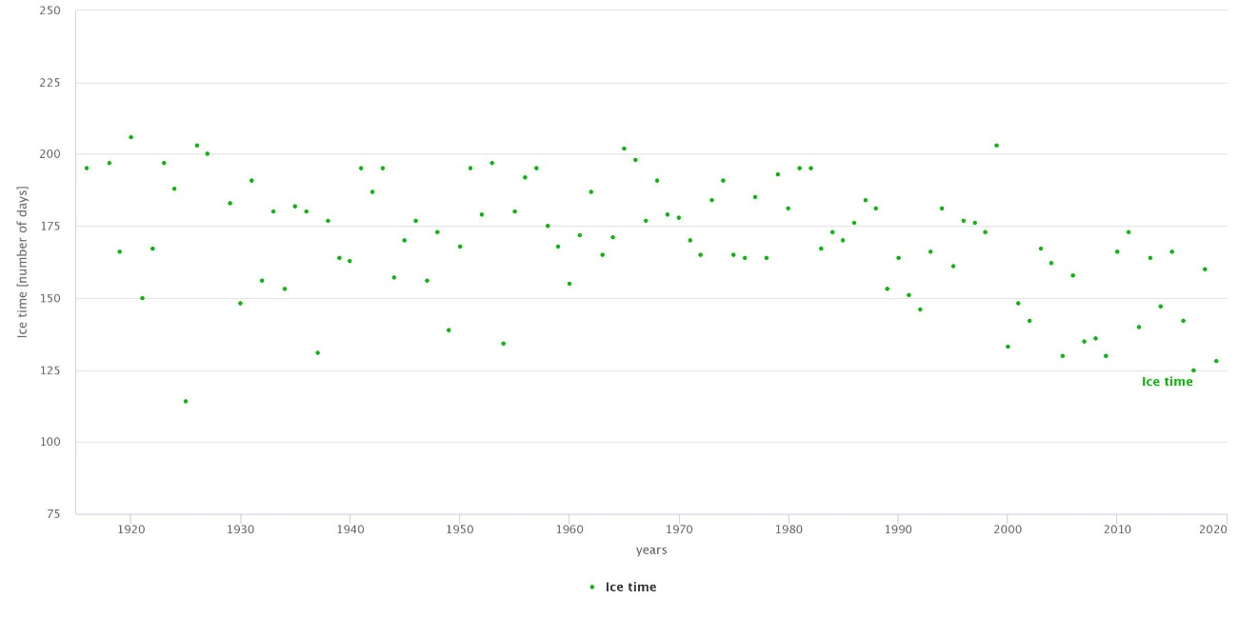
Torneträsk Ice Cover – Sweden’s Sea Ice
1989
Long-term reduction of over 44 days per year
ANS (unpublished data 2018)
Notes:
Figure taken from: Andrews, C., Dick, J., Jonasson, C. & Callaghan, T. Assessment of Biological and Environmental Phenology at a Landscape Level from 30 Years of Fixed-Date Repeat Photography in Northern Sweden. AMBIO 40, 600 (2011).
As the seventh largest lake in Sweden, a locally maritime climate is created by Lake Torneträsk, and the surrounding SAT during the summer is lowered, while during late autumn/early winter the energy exchange between the (still incompletely frozen) lake and surrounding terrain results in a warming influence on areas immediately surrounding the lake…

Slide 12
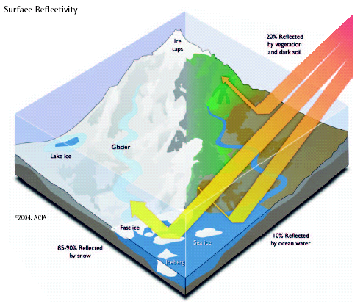
Accelerated warming of the Arctic
Atmosphere
thinner in Arctic
20% reflection by vegetation and dark soil
Solar radiation
Melting of snow and ice
greater absorption of heat
warming of thinner atmosphere
Positive feedback!
85-90% reflection by snow and ice
10% reflection by ocean (water)
Arctic Climate Impact Assessment (2004)
Notes:
Arctic Climate Impact Assessment. 2004. Impacts of a Warming Arctic: Arctic Climate Impact Assessment. Cambridge University Press, Cambridge, United Kingdom.

Slide 13
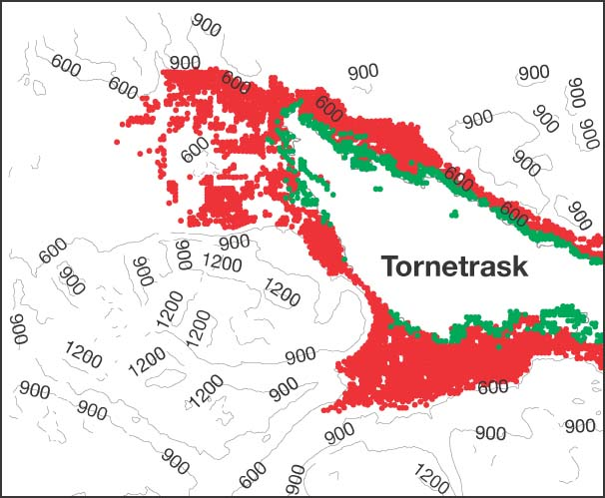
When is the warming occurring?
Temperature change from 1913 to 2017
• Green (1913) • Red (2008)
Comparison of the area around Abisko above 0°C mean annual temperature between 1913 and 2008.
Yang, Z., et al. Met. Apps 19, 454–463 (2012)
Notes:
Yang, Z., E. Hanna, T. V. Callaghan, and C. Jonasson. 2012. How can meteorological observations and microclimate simulations improve understanding of 1913–2010 climate change around Abisko, Swedish Lapland? Meteorological Applications 19:454–463.
This figure illustrates that the mean annual temperature was above 0 C primarily around the margins of the lake, but this has expanded upslope into the valleys.

Slide 14
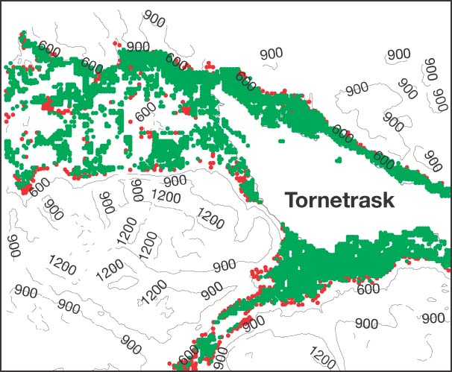
Warming across the year?
Temperature change from 1913 to 2017
• Green (1913) • Red (2008)
• Green (1913) • Red (2008)
The climate is warming in the winter not the summer…
Comparison of the area around Abisko above 10°C in July (warmest month) between 1913 and 2008.
Yang, Z., et al. Met. Apps 19, 454–463 (2012)
Notes:
Yang, Z., E. Hanna, T. V. Callaghan, and C. Jonasson. 2012. How can meteorological observations and microclimate simulations improve understanding of 1913–2010 climate change around Abisko, Swedish Lapland? Meteorological Applications 19:454–463.
This illustrates that the change has primarily occurred outside the summer months.

Slide 15
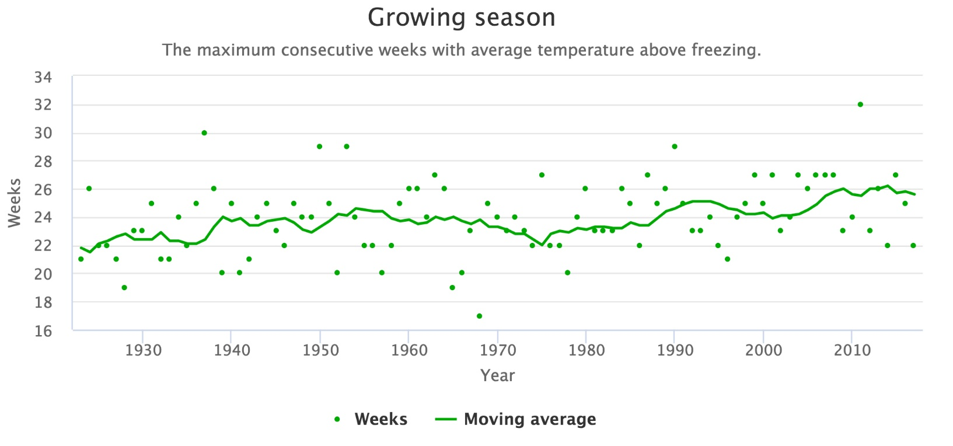
Growing season change from 1913 to 2017
Temperature change from 1913 to 2017
4 weeks longer over the last 100 years
* Mean weekly temperature above 0°C (Körner 2012)
ANS (unpublished data 2018)
Notes:
Data from ANS (2018)
Körner, C. 2012. Alpine treelines: functional ecology of the global high elevation tree limits. First edition. Springer, Basel.

Slide 16
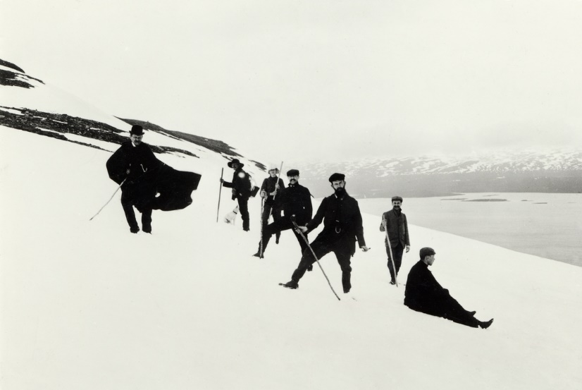
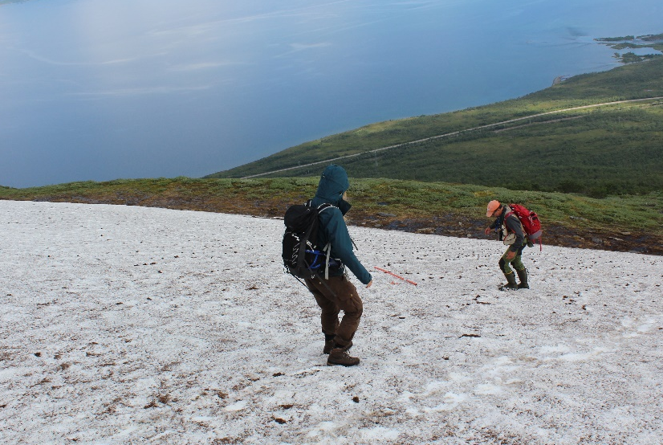
Species shifting their distributions
Approximately 230 m, 30 m elev.
21 February 1925
21 February 2017
Notes:
Treeline shifts and shrub zone expansion are driven by warming coupled with relaxed grazing pressure. Warming alone cannot account for the dramatic changes we have seen in the last century in places like Abisko National Park.
Photo 21 February 1925 taken by CG Alm in Fries (1925)
Thore C. E. Fries and others on Nuolja by Okänd from Nordiska museet
Photo 21 February 2017 taken by Oliver Wright
Photo Summer 1920 taken by CG Alm (postcard)
Photo 2017 taken by Anne-Karin Schäfer

Slide 17
How do climate changes impacts?
natural climate gradients
temperature
precipitation
experiments
Notes:
compare conditions across natural gradients in temperature, precipitation and permafrost conditions (i.e. ‘space for time substitution’)
compare lakes and streams along sharp precipitation (E-W, 300-1100 mm/yr) and temperature (elevation, difference in annual mean air temp around 5°C) gradients in northern Sweden

Slide 18
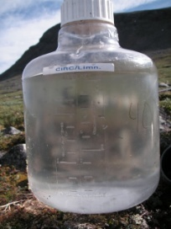
Case Study 1: Climate change induced regime shifts in northern lake ecosystems
CO₂, CH₄
Terrestrial inputs of carbon, nitrogen and phosphorus from rain and snowmelt runoff
Notes:
Lakes at high latitudes are important
Globally, lakes are concentrated at high latitudes where warming is predicted to be most pronounced
Northern lakes provide many important ecosystem services, including production of harvestable fish biomass and impacts on the global C cycle through burial of C in sediments and exchange of GHG with the atmosphere.
These ecosystem services are regarded highly sensitive to changes in climate conditions

Slide 19
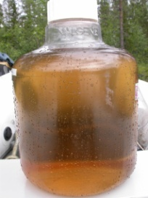
Results: Climate change induced regime shifts in northern lake ecosystems
CO₂, CH₄
Warming leads to increases in biological productivity
CO₂, CH₄
Notes:
Lakes at high latitudes are important
Globally, lakes are concentrated at high latitudes where warming is predicted to be most pronounced
Northern lakes provide many important ecosystem services, including production of harvestable fish biomass and impacts on the global C cycle through burial of C in sediments and exchange of GHG with the atmosphere.
These ecosystem services are regarded highly sensitive to changes in climate conditions.

Slide 20
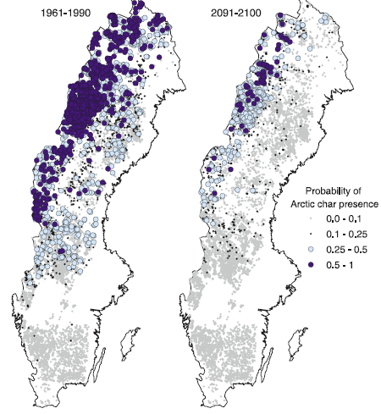
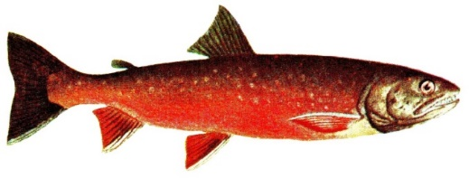
Results: Warming leads to changes in fish communities
Arctic Char
Röding
(Salvelinus alpinus)
Arctic char predicted to lose 73% of its range by 2100
Northern Pike
Gädda
(Esox lucius)
Hein et al. (2012)
Notes:
Hein, C. L., G. Ohlund, and G. Englund. 2012. Future Distribution of Arctic Char Salvelinus alpinus in Sweden under Climate Change: Effects of Temperature, Lake Size and Species Interactions. Ambio 41:303–312.
Novel communities will be formed as species with a variety of dispersal abilities and environmental tolerances respond individually to climate change. Thus, models projecting future species distributions must account for species interactions and differential dispersal abilities. We developed a species distribution model for Arctic char Salvelinus alpinus, a freshwater fish that is sensitive both to warm temperatures and to species interactions. A logistic regression model using lake area, mean annual air temperature (1961-1990), pike Esox lucius and brown trout Salmo trutta occurrence correctly classified 95 % of 467 Swedish lakes. We predicted that Arctic char will lose 73 % of its range in Sweden by 2100. Predicted extinctions could be attributed both to simulated temperature increases and to projected pike invasions. The Swedish mountains will continue to provide refugia for Arctic char in the future and should be the focus of conservation efforts for this highly valued fish.

Slide 21
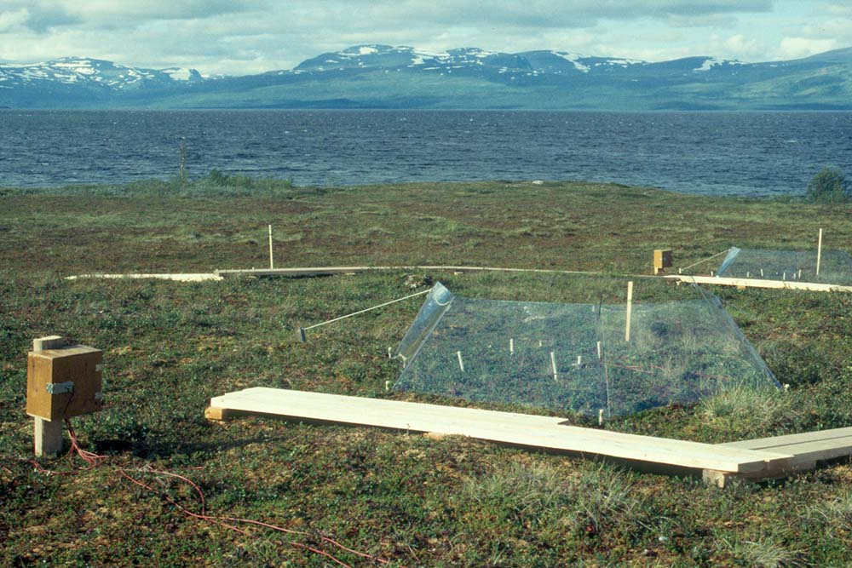
Experiment Study 1: How does increasing temperatures effect carbon emissions?
CO₂ uptake from photosynthesis (plants)
CO₂ and CH₄ from decomposition (in soils)
Do peatland soils function as a source or a sink under warming?
Notes:
“In the long-term experiment (eight years), we combined changes in summer and/or spring temperatures, winter snow thickness, or ambient conditions (for the four treatment combinations used here, see Fig. 1). In the companion experiment (two years) we combined spring and summer warming or ambient conditions with aboveground manipulation of the vegetation of part of the plots, so as to be able to partition total ecosystem respiration (intact part) into heterotrophic respiration (trenched-plus-clipped part) and plant-related respiration (aboveground, roots, rhizosphere; difference between intact and trenched-plus-clipped parts).”
“We used hexagonal OTCs that passively increased temperatures by up to approximately 1° C in both air and soil (to a depth of at least 20 cm, when used in spring and/or summer and passively doubled snow depth19 when used in winter, without consistently affecting soil moisture or active layer depth.”
Dorrepaal, E., S. Toet, R. S. P. van Logtestijn, E. Swart, M. J. van de Weg, T. V. Callaghan, and R. Aerts (2009). Carbon respiration from subsurface peat
accelerated by climate warming in the subarctic. Nature 460:616–619. doi: 10.1038/nature08216

Slide 22
How do open-top chambers work?
Trap solar radiation
Passive warming
Air Temperature
Spring: 0.3-1.0˚C
Summer: 0.2-0.9˚C
Block wind
Spring: 0.3-0.6˚C
Summer: 0.1-1.2˚C
Soil Temperature
Notes:
“In the long-term experiment (eight years), we combined changes in summer and/or spring temperatures, winter snow thickness, or ambient conditions (for the four treatment combinations used here, see Fig. 1). In the companion experiment (two years) we combined spring and summer warming or ambient conditions with aboveground manipulation of the vegetation of part of the plots, so as to be able to partition total ecosystem respiration (intact part) into heterotrophic respiration (trenched-plus-clipped part) and plant-related respiration (aboveground, roots, rhizosphere; difference between intact and trenched-plus-clipped parts).”
“We used hexagonal OTCs that passively increased temperatures by up to approximately 1° C in both air and soil (to a depth of at least 20 cm, when used in spring and/or summer and passively doubled snow depth19 when used in winter, without consistently affecting soil moisture or active layer depth.”
Dorrepaal, E., S. Toet, R. S. P. van Logtestijn, E. Swart, M. J. van de Weg, T. V. Callaghan, and R. Aerts (2009). Carbon respiration from subsurface peat
accelerated by climate warming in the subarctic. Nature 460:616–619. doi: 10.1038/nature08216

Slide 23
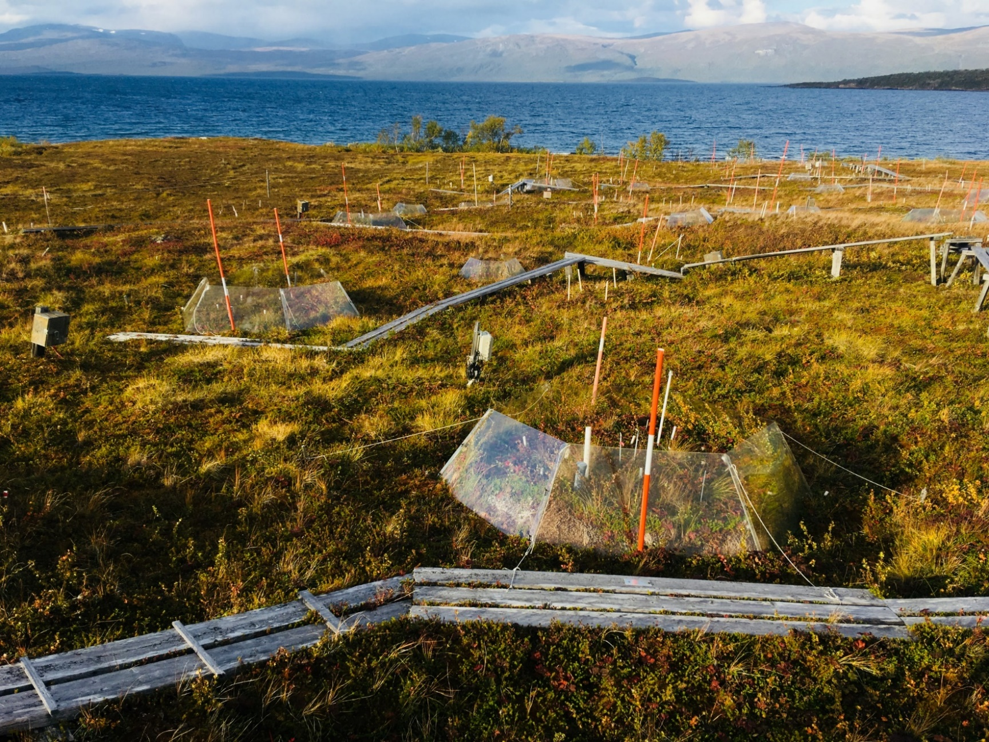
Experimental design
Control
Summer Warming (OTC)
Summer Warming (OTC)
Winter Snow Addition
Spring + Summer Warming (OTC)
Winter Snow Addition
Measure the carbon going in (photosynthesis) and carbon going out (primarily decomposition)
Dorrepaal et al. (2009)
Notes:
Warming increases carbon emissions through plant and soil (hetertropic) respiration
“Taking our data as indicative of the responses of undisturbed northern peatlands worldwide, we estimate that a mild growing-season temperature increase of about 1°C during the coming decades, as simulated by our OTC treatments, may induce a global increase in heterotrophic respiration from northern peatlands of 38–100 megatonnes of C per year (1 megatonne51012 g) (Supplementary Information). This estimate is based on direct summer warming effects only, because the OTCs did not consistently affect other environmental conditions, for example, soil moisture or active layer depth (Supplementary Information). While permafrost thawing and, depending on initial moisture conditions, drying of peatlands might further increase peat respiration the estimated potential extra global CO2 emission based on direct warming alone is enough to offset much of the Kyoto Protocol target for greenhouse gas emission reductions for the whole European Union (92 megatonnes of C per year). In economic terms, this extra CO2 emission would require an investment of 2.4–6.3 billion EUROS to compensate based on the current carbon allowance price of the EU Emissions Trading Scheme. Although our estimation may be crude, it clearly indicates the large, long-lasting potential feedback of increased respiration from northern peatlands to the global climate.”
Source for final statistic: https://www.iea.org/geco/
Dorrepaal, E., S. Toet, R. S. P. van Logtestijn, E. Swart, M. J. van de Weg, T. V. Callaghan, and R. Aerts (2009). Carbon respiration from subsurface peat accelerated by climate warming in the subarctic. Nature 460:616–619. doi: 10.1038/nature08216

Slide 24
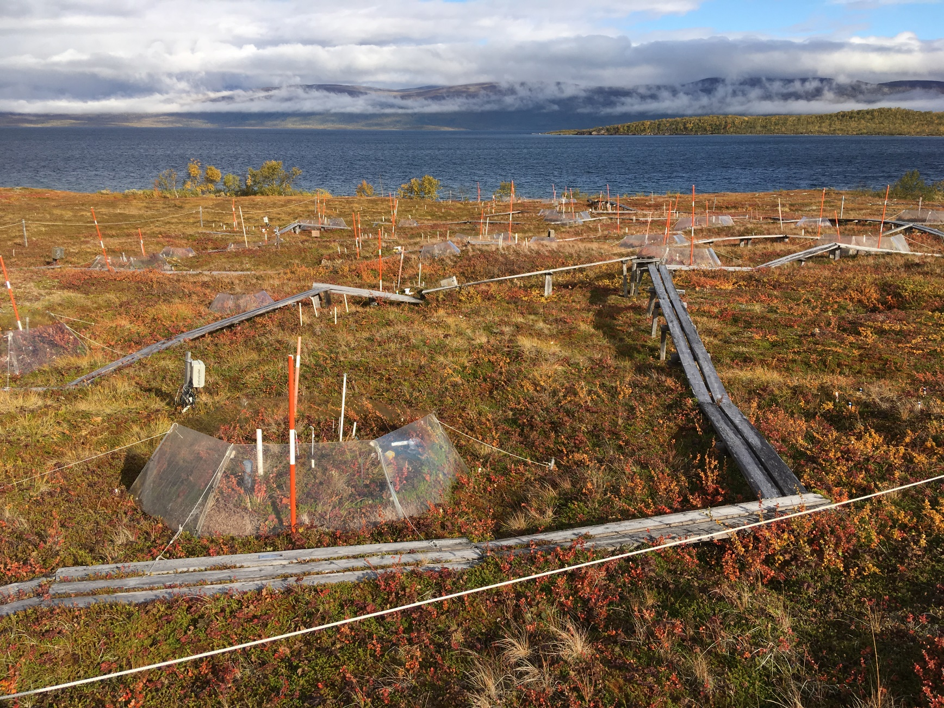
Results: Increased net ecosystem respiration
After four years all treatments significantly increased ecosystem respiration rates
Northern peatlands cover only 2% of the land, their thick peat deposits contain one-third of the world’s soil organic carbon
Soil carbon respiration is highly sensitivity to climate warming with long-lasting effects
Upscale to all northern peatlands with warming of 1°C results in the increase of an estimated 38-100 megatonnes of carbon emissions per year
Global warming causes large & long-lasting “positive feedback” of carbon stored in peatlands to the global climate
CO₂
CO₂
CO₂
Not to Scale
CO₂
Ecosystem Respiration
Dorrepaal et al. (2009)
Dorrepaal et al. (2009)
Notes:
Warming increases carbon emissions through plant and soil (hetertropic) respiration
“Taking our data as indicative of the responses of undisturbed northern peatlands worldwide, we estimate that a mild growing-season temperature increase of about 1°C during the coming decades, as simulated by our OTC treatments, may induce a global increase in heterotrophic respiration from northern peatlands of 38–100 megatonnes of C per year (1 megatonne51012 g) (Supplementary Information). This estimate is based on direct summer warming effects only, because the OTCs did not consistently affect other environmental conditions, for example, soil moisture or active layer depth (Supplementary Information). While permafrost thawing and, depending on initial moisture conditions, drying of peatlands might further increase peat respiration the estimated potential extra global CO2 emission based on direct warming alone is enough to offset much of the Kyoto Protocol target for greenhouse gas emission reductions for the whole European Union (92 megatonnes of C per year). In economic terms, this extra CO2 emission would require an investment of 2.4–6.3 billion EUROS to compensate based on the current carbon allowance price of the EU Emissions Trading Scheme. Although our estimation may be crude, it clearly indicates the large, long-lasting potential feedback of increased respiration from northern peatlands to the global climate.”
Source for final statistic: https://www.iea.org/geco/
Dorrepaal, E., S. Toet, R. S. P. van Logtestijn, E. Swart, M. J. van de Weg, T. V. Callaghan, and R. Aerts (2009). Carbon respiration from subsurface peat accelerated by climate warming in the subarctic. Nature 460:616–619. doi: 10.1038/nature08216

Slide 25
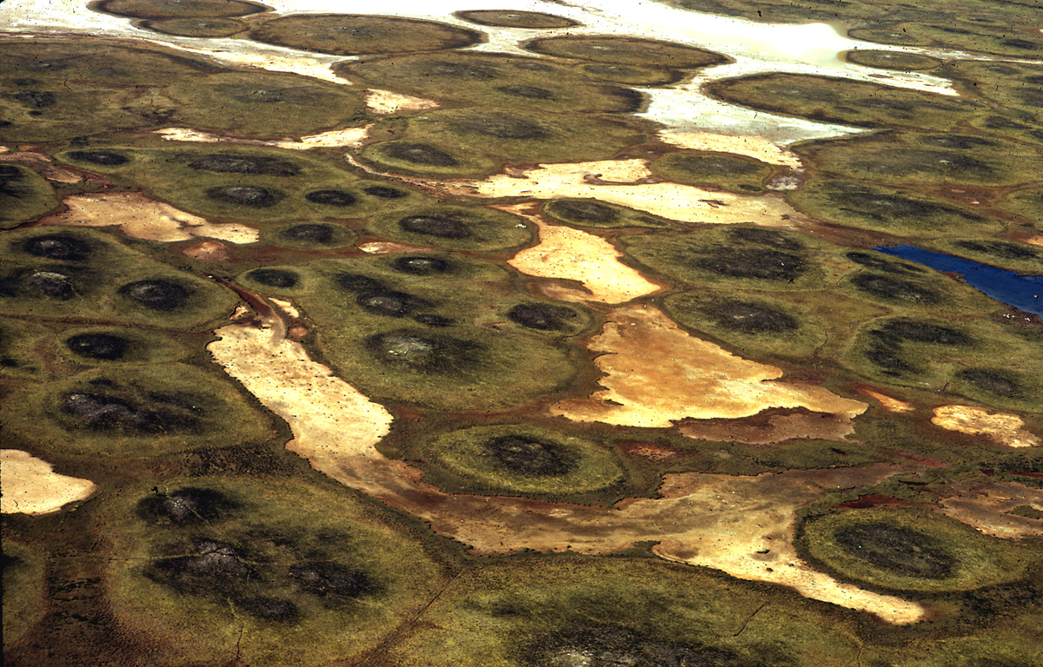
Experiment Study 2: Effects of increasing snow depth on permafrost
Permafrost: Earth material that remains at or below 0°C for at least 2 consecutive years
Aerial view of permafrost mire
Notes:
“Permafrost carbon is the remnant of plants and animals accumulated in perennially frozen soil over thousands of years, and the permafrost region
contains twice as much carbon as there is currently in the atmosphere.”
Schuur, E. A. G., A. D. McGuire, C. Schädel, G. Grosse, J. W. Harden, D. J. Hayes, G. Hugelius, C. D. Koven, P. Kuhry, D. M. Lawrence, S. M. Natali, et al. (2015). Climate change and the permafrost carbon feedback. Nature 520:171–179. doi: 10.1038/nature14338

Slide 26
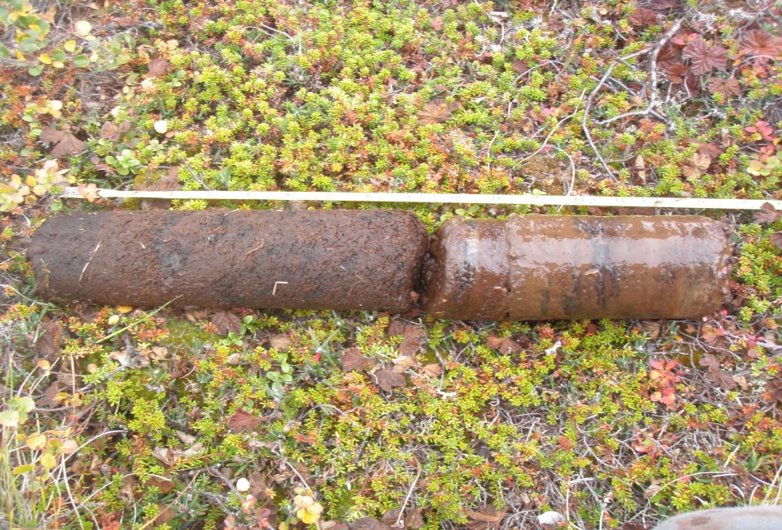
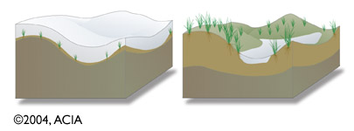
Active layer: the top layer of permafrost that thaws each year during the warm season and freezes again in winter
Active Layer
Permafrost
Winter
Summer
Active Layer
Permafrost
Notes:
Figure source: http://www.acia.uaf.edu/ - Arctic Climate Impacts Assessment (2004)
Photo source: Climate Impacts Research Centre, Umeå University

Slide 27
Warming increases biological productivity
Warmer climate leads to expansion of shrubs into the tundra
Ground temperature under snow not linked to air temperature when snow greater than 1 meter
Notes:
Prediction increase in shrub vegetation in tundra habitats
Further prediction that increase in shrub vegetation increase downwind snow cover → thus increasing the depth of the active layer resulting in increased availability of CO2 and CH4 previously captured in permafrost.
Need plot (Niki’s talk) and citation for the decoupling of ground temperature from air temperature when snow depth reaches 1 meter

Slide 28
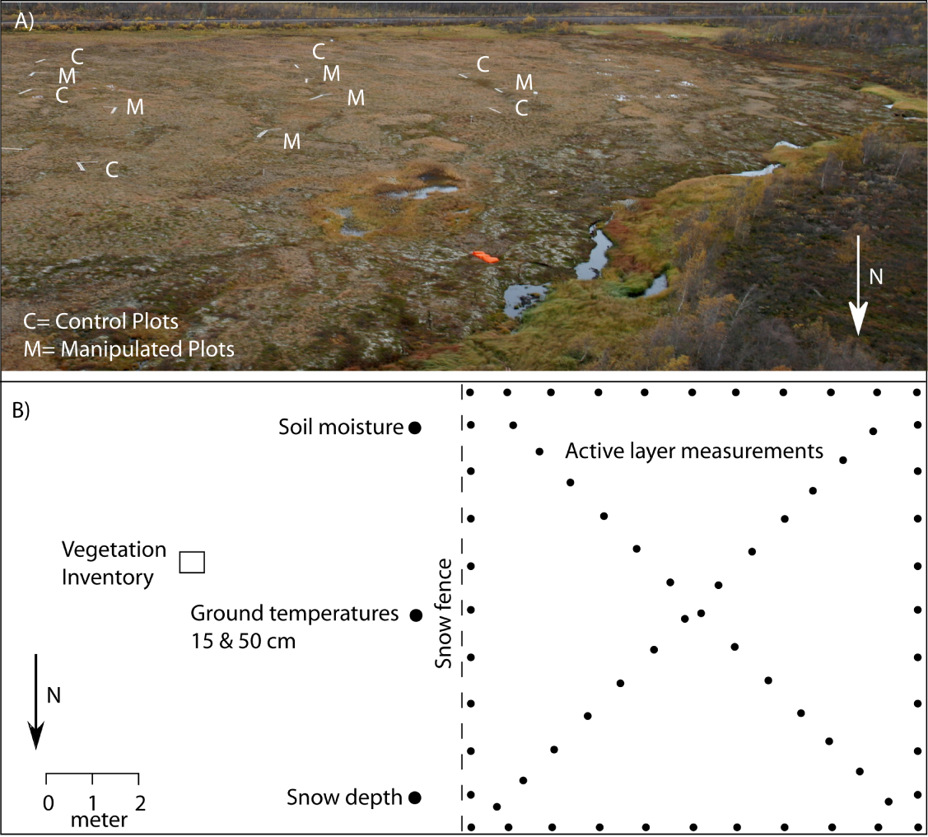
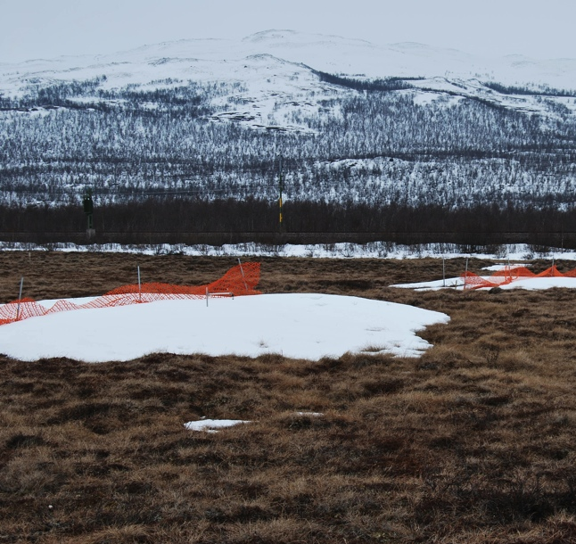
Snow fence experimental design
Johansson et al. (2013)
Notes:
Johansson, M., T. V. Callaghan, J. Bosiö, H. J. Åkerman, M. Jackowicz-Korczynski, and T. R. Christensen (2013). Rapid responses of permafrost and vegetation to experimentally increased snow cover in sub-arctic Sweden. Environmental Research Letters 8:035025. doi: 10.1088/1748-9326/8/3/035025

Slide 29
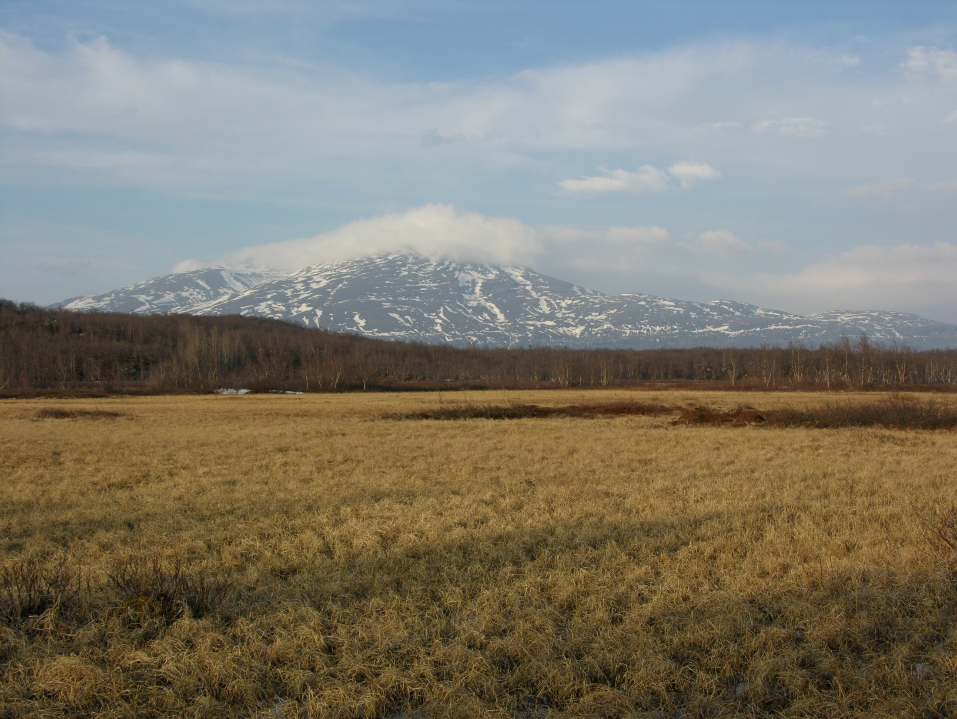
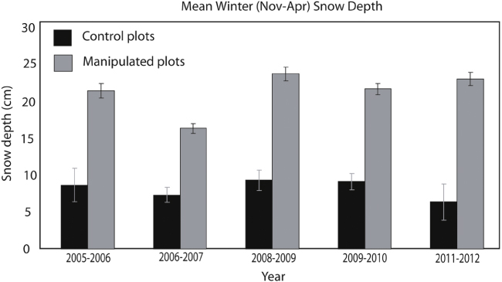
Snow depth increases
Johansson et al. (2013)
Notes:
Storflaket Snow fences
Permafrost thaw causes the ground to become unstable as the soil collapses. This can damage building and roads built on permafrost. Cracks also expose the carbon stored within to sunlight, which may speed the release of carbon dioxide, a greenhouse gas.
Johansson, M., T. V. Callaghan, J. Bosiö, H. J. Åkerman, M. Jackowicz-Korczynski, and T. R. Christensen (2013). Rapid responses of permafrost and vegetation to experimentally increased snow cover in sub-arctic Sweden. Environmental Research Letters 8:035025. doi: 10.1088/1748-9326/8/3/035025

Slide 30
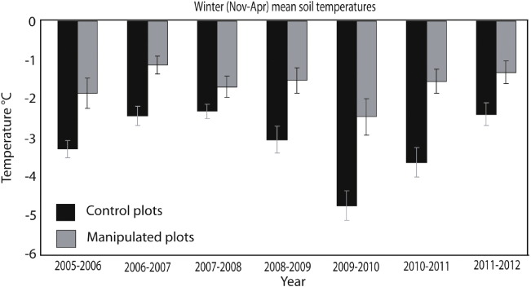
Below ground temperatures decreases
Below ground temperatures increased 1.5 C
Johansson et al. (2013)
Notes:
Storflaket Snow fences
Permafrost thaw causes the ground to become unstable as the soil collapses. This can damage building and roads built on permafrost. Cracks also expose the carbon stored within to sunlight, which may speed the release of carbon dioxide, a greenhouse gas.
Johansson, M., T. V. Callaghan, J. Bosiö, H. J. Åkerman, M. Jackowicz-Korczynski, and T. R. Christensen (2013). Rapid responses of permafrost and vegetation to experimentally increased snow cover in sub-arctic Sweden. Environmental Research Letters 8:035025. doi: 10.1088/1748-9326/8/3/035025

Slide 31
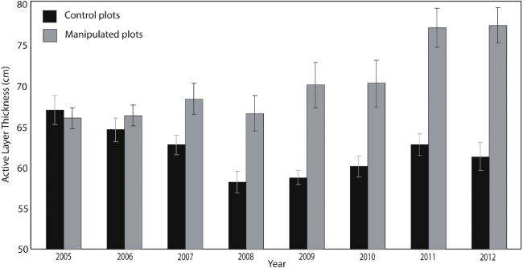
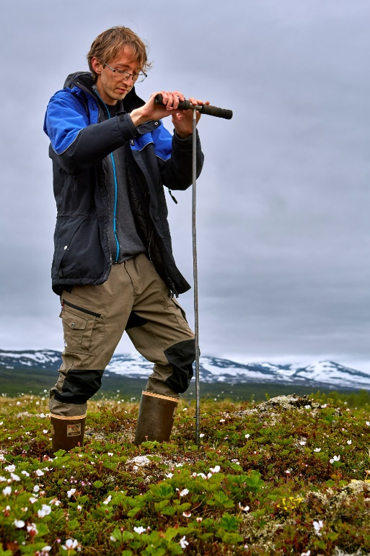
Active layer depth increases
Active layer depth increased 20%
Johansson et al. (2013)
Notes:
Johansson, M., T. V. Callaghan, J. Bosiö, H. J. Åkerman, M. Jackowicz-Korczynski, and T. R. Christensen (2013). Rapid responses of permafrost and vegetation to experimentally increased snow cover in sub-arctic Sweden. Environmental Research Letters 8:035025. doi: 10.1088/1748-9326/8/3/035025

Slide 32
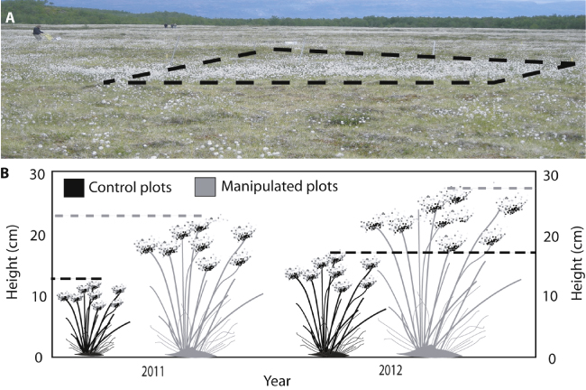
Increasing biological productivity
Johansson et al. (2013)
Notes:
Johansson, M., T. V. Callaghan, J. Bosiö, H. J. Åkerman, M. Jackowicz-Korczynski, and T. R. Christensen (2013). Rapid responses of permafrost and vegetation to experimentally increased snow cover in sub-arctic Sweden. Environmental Research Letters 8:035025. doi: 10.1088/1748-9326/8/3/035025
Additionally, we know from these studies that annual greenhouse gas emissions from thawed permafrost exceed that taken up by plants and animals (need to CITE).

Slide 33
Surface subsidence leads to thaw ponds
Surface subsidence as much as 35 cm
Johansson et al. (2013)
Notes:
Johansson, M., T. V. Callaghan, J. Bosiö, H. J. Åkerman, M. Jackowicz-Korczynski, and T. R. Christensen (2013). Rapid responses of permafrost and vegetation to experimentally increased snow cover in sub-arctic Sweden. Environmental Research Letters 8:035025. doi: 10.1088/1748-9326/8/3/035025

Slide 34
Thaw ponds lead to significant changes in greenhouse gas emissions
Source
MeHg
CO₂
CH₄
Sink
Not to Scale
CH₄
Permafrost Thaw
CO₂
Kuhn et al. (2018)
Fahnestock et al. (2019)
Notes:
Kuhn, M., E. J. Lundin, R. Giesler, M. Johansson, and J. Karlsson. 2018. Emissions from thaw ponds largely offset the carbon sink of northern permafrost wetlands. Scientific Reports 8:9535.
As thaw ponds form they drive the permafrost mire ecosystems from a carbon sink to a source.

Slide 35
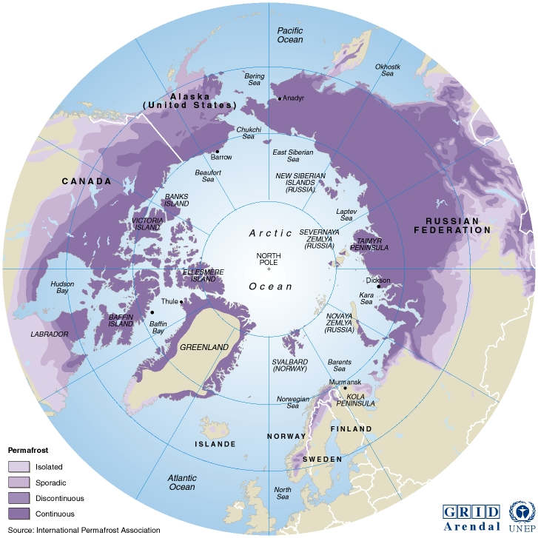
Feedbacks from the Arctic: Permafrost
24% of the terrestrial soils in the Northern Hemisphere or 12% globally
Abisko
Notes:
Figure taken from:
Turetsky, M. R., B. W. Abbott, M. C. Jones, K. W. Anthony, D. Olefeldt, E. A. G. Schuur, C. Koven, A. D. McGuire, G. Grosse, P. Kuhry, G. Hugelius, D. M. Lawrence, C. Gibson, and A. B. K. Sannel. 2019. Permafrost collapse is accelerating carbon release. Nature 569:32–34.
based on original paper:
Hugelius, G., J. Strauss, S. Zubrzycki, J. W. Harden, E. a. G. Schuur, C.-L. Ping, L. Schirrmeister, G. Grosse, G. J. Michaelson, C. D. Koven, J. A. O’Donnell, B. Elberling, U. Mishra, P. Camill, Z. Yu, J. Palmtag, and P. Kuhry. 2014. Estimated stocks of circumpolar permafrost carbon with quantified uncertainty ranges and identified data gaps. Biogeosciences 11:6573–6593.
“In high-latitude regions of Earth, temperatures have risen 0.6°C per decade over the last 30 years, twice as fast as the global average1. This is causing normally frozen ground to thaw, exposing substantial quantities of organic carbon to decomposition by soil microbes.” (Schuur et al. 2015)
Schuur, E. A. G., A. D. McGuire, C. Schädel, G. Grosse, J. W. Harden, D. J. Hayes, G. Hugelius, C. D. Koven, P. Kuhry, D. M. Lawrence, S. M. Natali, et al. (2015). Climate change and the permafrost carbon feedback. Nature 520:171–179. doi: 10.1038/nature14338

Slide 36
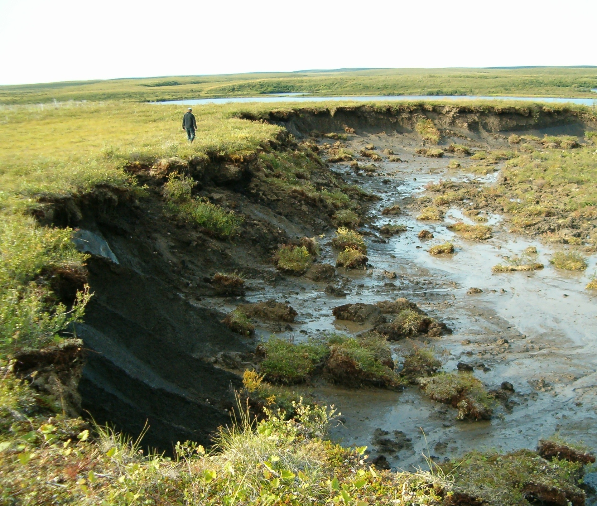
Total amount of soil carbon in permafrost regions
Approx. 1,035 billion tons in top 3 m
50% of global soil organic C pool
Approx. twice the amount of C in atmosphere
Forecast: 13-28% will thaw in Arctic by 2050
Slow climate feedbacks not incorporated in the global climate models
Photo: Megan Thompson
Notes:
Photo: Megan Thompson
The rest of Earth’s biomes, excluding the Arctic and boreal regions, are thought to contain 2,050 Pg carbon in the surface 3m of soil. Even though these northern regions account for only 15% of global soil area, the 0–3m global soil carbon pool is increased by 50% when fully accounting for the carbon stored deeper in permafrost zone soil profiles.
50% of global soil organic C pool or 1.7 trillion tons
Tarnocai, C., J. G. Canadell, E. a. G. Schuur, P. Kuhry, G. Mazhitova, and S. Zimov. 2009. Soil organic carbon pools in the northern circumpolar permafrost region. Global Biogeochemical Cycles 23:GB2023.
Turetsky, M. R., B. W. Abbott, M. C. Jones, K. W. Anthony, D. Olefeldt, E. A. G. Schuur, C. Koven, A. D. McGuire, G. Grosse, P. Kuhry, G. Hugelius, D. M. Lawrence, C. Gibson, and A. B. K. Sannel. 2019. Permafrost collapse is accelerating carbon release. Nature 569:32–34.
Approx. twice the amount of C in atmosphere
Zimov, S. A., E. A. G. Schuur, and F. S. Chapin. 2006. Permafrost and the Global Carbon Budget. Science 312:1612–1613.
Turetsky, M. R., B. W. Abbott, M. C. Jones, K. W. Anthony, D. Olefeldt, E. A. G. Schuur, C. Koven, A. D. McGuire, G. Grosse, P. Kuhry, G. Hugelius, D. M. Lawrence, C. Gibson, and A. B. K. Sannel. 2019. Permafrost collapse is accelerating carbon release. Nature 569:32–34.
Climate change models predict a 13%–28% decrease in Arctic permafrost by 2050 (Schuur et al., 2015 and Tarnocai et al., 2009)
Tundra ecosystems contain huge stores of carbon in soil organic matter (Jones et al., 2014), and any shifts in the balance between photosynthesis and respiration could potentially have a major impact on carbon sequestration (Oechel et al., 1994).
Jones AG, Scullion J, Ostle N, Levy PE, Gwynn-Jones D. 2014. Completing the FACE of elevated CO2 research. Environment International 73:252-258
Oechel WC, Cowles S, Grulke N, Hastings SJ, Lawrence B, Prudhomme T, Riechers G, Strain B, Tissue D, Vourlitis G. 1994. Transient nature of CO2 fertilization in Arctic tundra. Nature 371:500-503

Slide 37
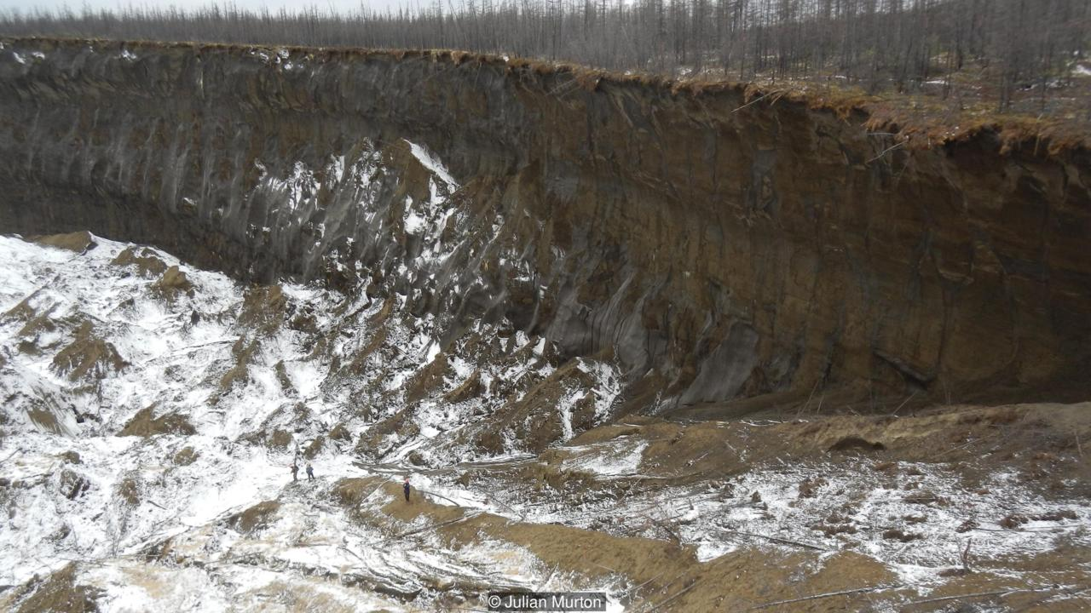
Permafrost crater in Siberia
Batagaika crater
Notes:
Photo: The crater grows more each year (Credit: Julian Murton)
Source: http://www.bbc.com/earth/story/20170223-in-siberia-there-is-a-huge-crater-and-it-is-getting-bigger
More information: https://en.wikipedia.org/wiki/Batagaika_crater

Slide 38
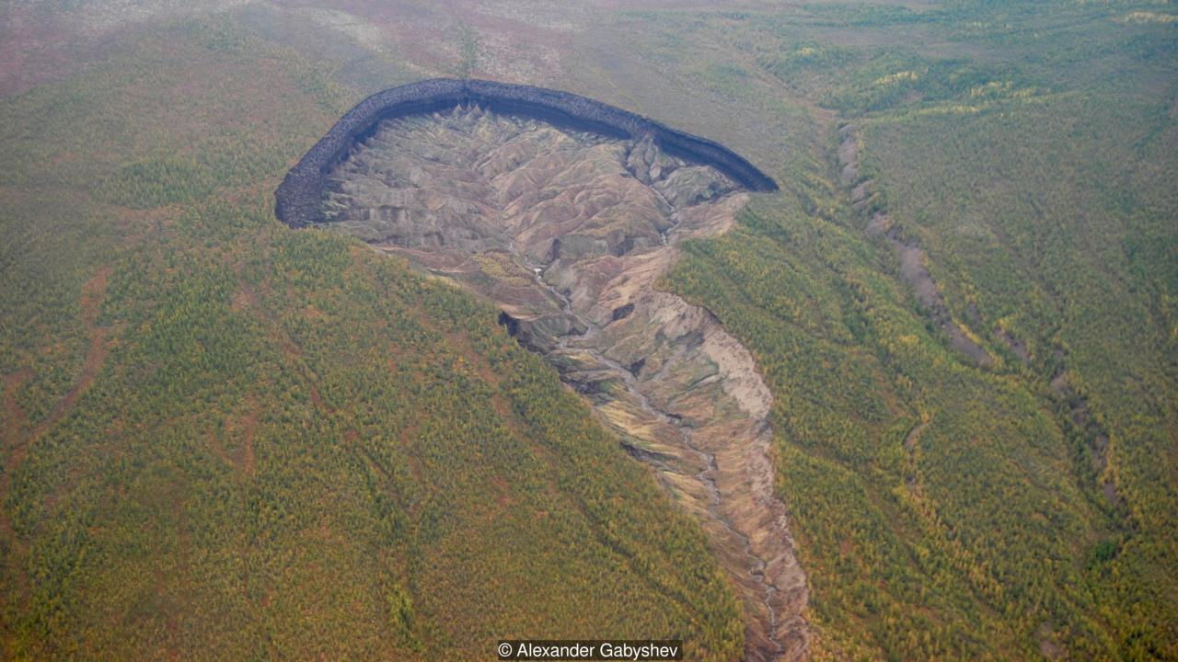
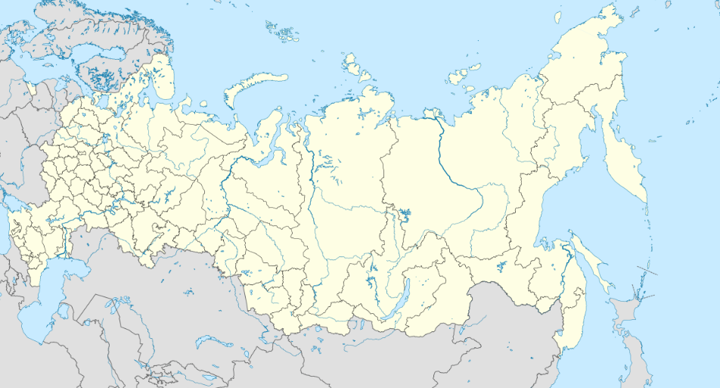
Permafrost crater in Siberia
Batagaika crater
Siberia
Notes:
Photo: The ground here is frozen year-round (Credit: Alexander Babyshev)
Map: taken from https://en.wikipedia.org/wiki/File:Russia_edcp_location_map.svg
Source: http://www.bbc.com/earth/story/20170223-in-siberia-there-is-a-huge-crater-and-it-is-getting-bigger
More information: https://en.wikipedia.org/wiki/Batagaika_crater
The land began to sink due to the thawing permafrost in the 1960s after the surrounding forest was cleared.
Read more at: https://www.nationalgeographic.com/environment/2019/08/arctic-permafrost-is-thawing-it-could-speed-up-climate-change-feature/

Slide 39
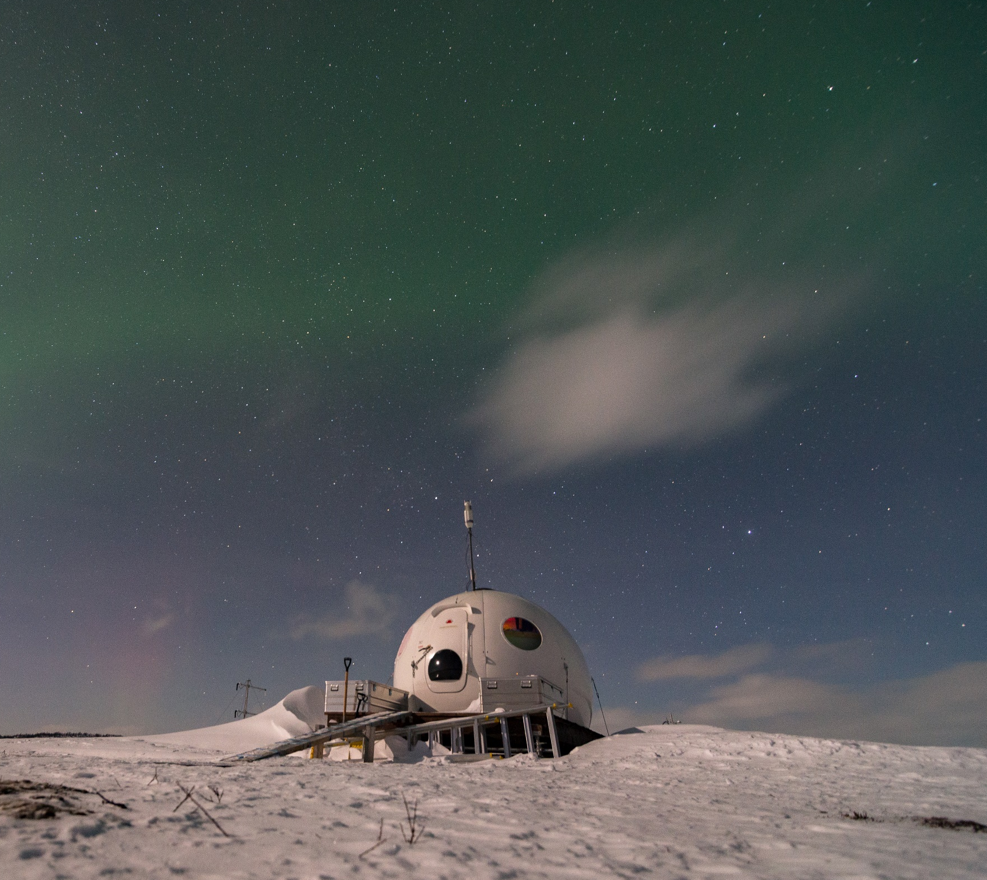
The Arctic region gives off more heat to space than it absorbs from outside, which helps cool the planet.
The Arctic functions as the earth’s cooling system
Changes in the Arctic climate are significant globally!
Notes:
Photo taken by Keith Larson

Slide 40
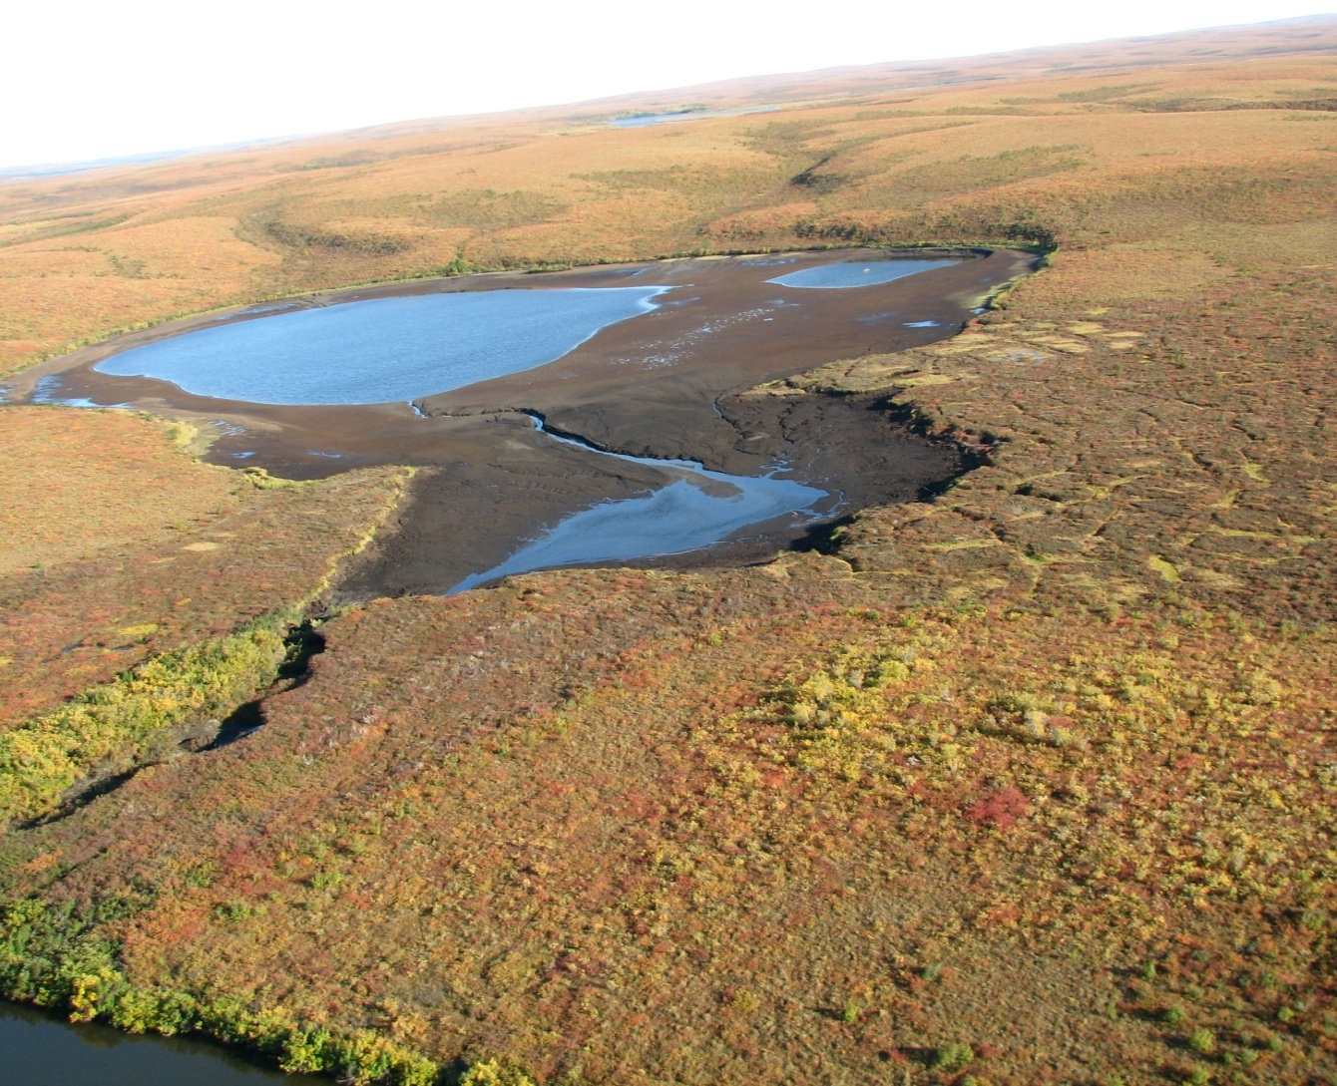
Connecting the Arctic and the global climate system
Scientific evidence for warming of the climate system is unequivocal.
- Intergovernmental Panel on Climate Change (2013)
Carbon Dioxide
↑411.6
Parts per million
Global Temperature
↑1.1 °C
Since 1880
Arctic Temperature
↑1.8°C
Last 30 years
Arctic Ice Minimum
↓12.8
Percent per decade
Ice Sheets
↓413.0
Gigetonnes per year
Sea Level
↑3.3
mm per year
Notes:
CO2 levels from https://scripps.ucsd.edu/programs/keelingcurve/
Other vital signs of the planet http://climate.nasa.gov/vital-signs/
Land Ice = Greenland Ice Sheet (Antarctica losing approximately 118 GGT/per year)

Slide 41
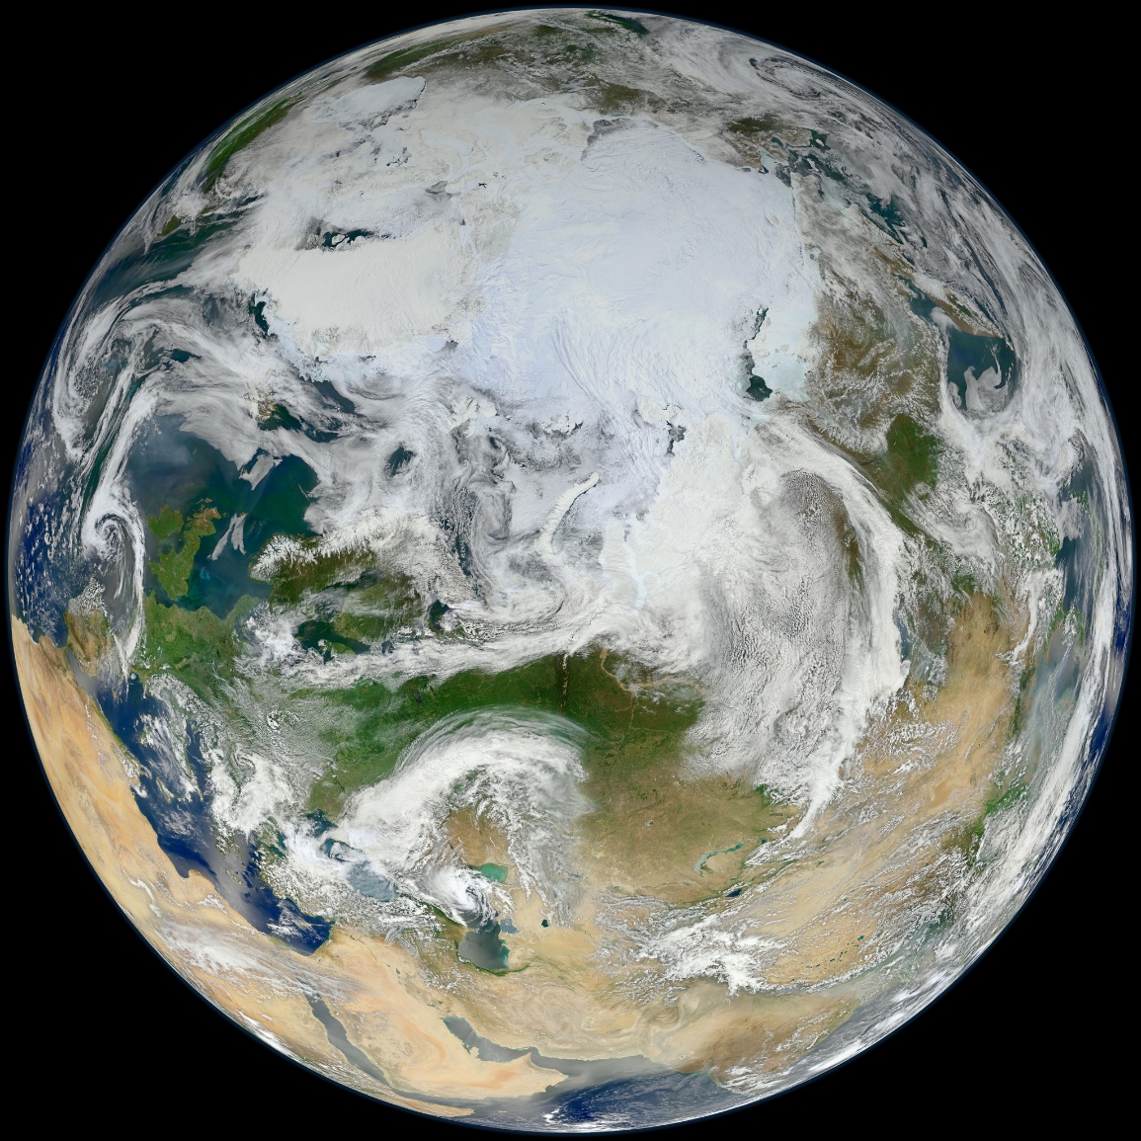
Our Global Climate
Greenhouse gases effect global temperatures!
Average temperature on earth is + 15°C
Without greenhouse gases -18°C

Slide 42
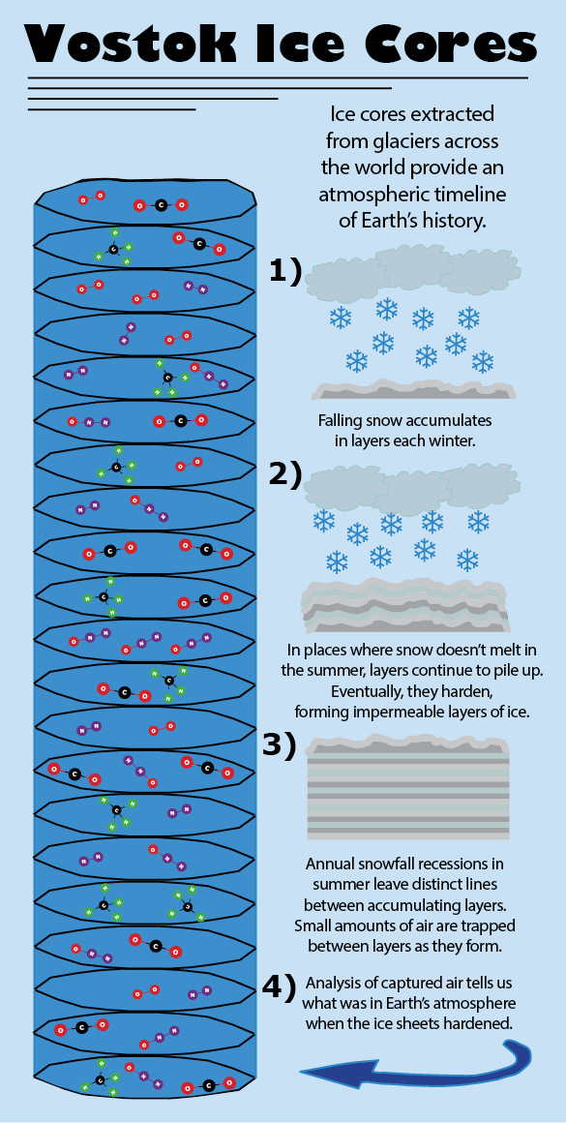
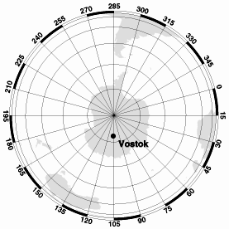
How do we understand past climate changes?
Vostok, Antarctica 78°28' S, 106°48'E 3488 m amsl
Notes:
Figure 1 taken from: http://earthobservatory.nasa.gov/Features/Paleoclimatology_IceCores/
Figure 2 taken from: https://dakotastudent.com/5581/features/greenhouse-gases/ (created by William Beaton)

Slide 43
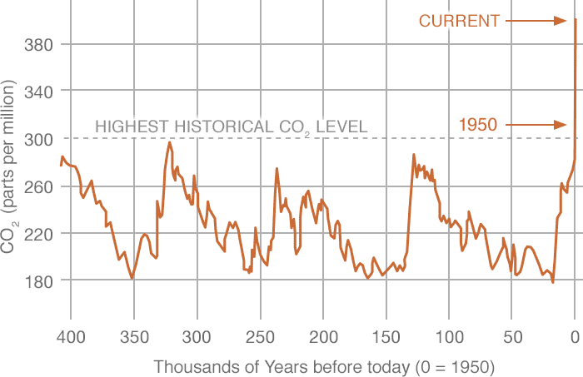
What does history tell us using the Vostok Ice Core?
411.6 ppm
Vostok, Antarctica 78°28' S, 106°48'E 3488 m amsl
Source: NASA (2016)
Notes:
Source: https://climate.nasa.gov/vital-signs/carbon-dioxide/

Slide 44
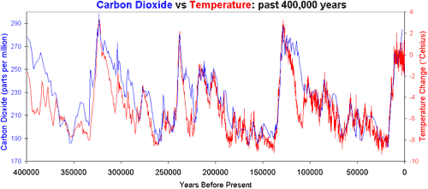
Why does temperature lag CO₂ atmospheric concentrations?
Deglaciation (warming) is not initiated by CO₂ but by orbital cycles
CO₂ amplifies warming which is not explained only by orbital cycles
CO₂ spreads warming throughout the planet
Notes:
http://www.skepticalscience.com/co2-lags-temperature-intermediate.htm

Slide 45
Current Atmospheric CO₂
411.6 ppm
“We were witnessing for the first time nature’s withdrawing CO₂ from the air for plant growth during the summer and returning it each succeeding winter.”
- Charles David Keeling (1998)
Notes:
https://scripps.ucsd.edu/programs/keelingcurve/
Most current conditions (24-hours)
The “Keeling Curve” is a set of careful measurements of atmospheric CO₂ that Charles David Keeling began collecting in 1958. The data show a steady annual increase in CO₂ plus a small up-and-down sawtooth pattern each year that reflects seasonal changes in plant activity (plants take up CO2 during spring and summer in the Northern Hemisphere, where most of the planet’s land mass and land ecosystems reside, and release it in fall and winter). Source: National Research Council, 2010a
Source: Tans, P. 2010. NOAA/ESRL (NOAA Earth System Research Laboratory) Trends in Atmospheric Carbon Dioxide. Available at http://www.esrl.noaa.gov/gmd/ccgg/trends/.

Slide 46
Recent Atmospheric CO₂
411.6 ppm
2013: 400 ppm first time passed in human history
12 June 1968: 325.42
Notes:
https://scripps.ucsd.edu/programs/keelingcurve/
The complete series (1958 to present)
On 9 May 2013, the daily average concentration of CO₂ in our planet's atmosphere, measured at the famous Mauna Loa Observatory in Hawaii, crept above 400 parts per million for the first time since humans walked the Earth. Researchers have kept tabs on the atmosphere's climbing CO₂ levels since Charles Keeling set up this Hawaiian lab in 1958. Back then, levels were at 316 ppm, a little higher than the 280 ppm that was typical for thousands of years before the industrial revolution. The last time global levels of CO₂ hit 400 ppm is thought to have been more than 2.5 million years ago during the Pliocene, when temperatures were about 3 degrees warmer than today. Our current climate has not yet had a chance to catch up with our high CO₂ levels. (Jones, N. 2013. Troubling milestone for CO2. Nature Geoscience 6:589–589. doi: 10.1038/ngeo1900).

Slide 47
NASA’s global temperature record
1.1° C warming since 1880!
The oceans have taken up over 90% of the warming and approximately 1/3 of carbon dioxide released since the pre-industrial period
Notes:
Top Figure Source: https://climate.nasa.gov/vital-signs/global-temperature/
Bottom Figure Source: https://skepticalscience.com/graphics.php?g=65
The oceans are currently absorbing approximately 93% of the energy from global warming (adapted from IPCC AR5 Box 3.1, Figure 1) - in the long run the ocean will equilibrate with the atmosphere (they are connected!) and atmospheric temperature will rise
Also see:
von Schuckmann, K., M. D. Palmer, K. E. Trenberth, A. Cazenave, D. Chambers, N. Champollion, J. Hansen, S. A. Josey, N. Loeb, P.-P. Mathieu, B. Meyssignac, and M. Wild. 2016. An imperative to monitor Earth’s energy imbalance. Nature Climate Change 6:138–144.
Estimates of global surface temperature change, relative to the average global surface temperature for the period from 1951 to 1980, which is about 14°C (57°F) from NASA Goddard Institute for Space Studies show a warming trend over the 20th century. The estimates are based on surface air temperature measurements at meteorological stations and on sea surface temperature measurements from ships and satellites. The black curve shows average annual temperatures, and the red curve is a 5-year running average. The green bars indicate the margin of error, which has been reduced over time. Source: National Research Council 2010a
Source: NASA GISS (2010, based on Hansen, J., M. Sato, R. Ruedy, K. Lo, D. W. Lea, and M. Medina-Elizade. 2006. Global temperature change. Proceedings of the National Academy of Sciences of the United States of America 103(39):14288-14293. Updated through 2009 at http://data.giss.nasa.gov/gistemp/graphs/).
Taken from: http://data.giss.nasa.gov/gistemp/graphs_v3/

Slide 48
How do we tackle big problems?
Scientific Evidence → Global Collaboration
The first successful vaccine to be developed, Edward Jenner in 1796
192 years between first vaccination and eradication (1988)
Notes:
https://ourworldindata.org/wp-content/uploads/2014/06/decade-in-which-smallpox-ceased-to-be-endemic-by-country.png

Slide 49
How do we tackle big problems?
Scientific Evidence → Global Collaboration
Montreal Protocol signed: 16 September 1987
The first universally ratified treaties in United Nations history.
14 years between research discovery in 1973 and the international agreement in 1987.
Notes:
https://svs.gsfc.nasa.gov/vis/a000000/a003500/a003586/Waleed30secondMontrealProtocolVizComposite.900_print.jpg

Slide 50
Lack of compelling narratives

Slide 51
Our current trajectory
Estimated emissions in 2019: 36.8 billion tons
*emissions have grown by 62% since international climate negotiations began in 1990 to address the problem
Notes:
Source: https://scripps.ucsd.edu/programs/keelingcurve/wp-content/plugins/sio-bluemoon/graphs/RCP85_scenario.png
Quote: https://public.wmo.int/en/media/press-release/landmark-united-science-report-informs-climate-action-summit
Source of CO2 statistics: https://www.globalcarbonproject.org/carbonbudget/18/presentation.htm
2.7% increase from https://www.carbonbrief.org/analysis-fossil-fuel-emissions-in-2018-increasing-at-fastest-rate-for-seven-years

Slide 52
Lack of Action
Notes:
Jackson, R. B., P. Friedlingstein, R. M. Andrew, J. G. Canadell, C. L. Quéré, and G. P. Peters. 2019. Persistent fossil fuel growth threatens the Paris Agreement and planetary health. Environmental Research Letters 14:121001.
Jackson, R. B., C. L. Quéré, R. M. Andrew, J. G. Canadell, J. I. Korsbakken, Z. Liu, G. P. Peters, and B. Zheng. 2018. Global energy growth is outpacing decarbonization. Environmental Research Letters 13:120401.
Peters, G. P., R. M. Andrew, J. G. Canadell, P. Friedlingstein, R. B. Jackson, J. I. Korsbakken, C. L. Quéré, and A. Peregon. 2019. Carbon dioxide emissions continue to grow amidst slowly emerging climate policies. Nature Climate Change:1–4.

Slide 53
Climate Action / Lack of Action
Notes:
https://public.wmo.int/en/media/press-release/landmark-united-science-report-informs-climate-action-summit

Slide 54
How do we make sense of this?
Notes:
The best way to reduce your carbon footprint is one the government isn’t telling you about. http://www.sciencemag.org/news/2017/07/best-way-reduce-your-carbon-footprint-one-government-isn-t-telling-you-about.

Slide 55
How do we make sense of this?
Notes:
Living on the veg: Should we all go vegan? - Source: https://www.newscientist.com/article/mg23731623-000-living-on-the-veg-should-we-all-go-vegan/
Scarborough, P., P. N. Appleby, A. Mizdrak, A. D. M. Briggs, R. C. Travis, K. E. Bradbury, and T. J. Key. 2014. Dietary greenhouse gas emissions of meat-eaters, fish-eaters, vegetarians and vegans in the UK. Climatic Change 125:179–192.
These view of individual responsibility are wrong! Of course, affluent people who have been the major source of climate change, biodiversity loss, and environmental degradation should take responsibility. But, these are big problems, that require a collective and global perspective. We must focus on fighting inequalities, gender, environmental, economic and social injustices, as if we can deal with these will have a decent start on making the changes necessary to save humanity.

Slide 56
A path to renewal “clean” energy
18 TW
Notes:
https://below2c.org/2018/03/solar-power-here-comes-the-sun/
2015 world consumption now estimated at 18.5 TW (https://www.iea-shc.org/data/sites/1/publications/2015-11-A-Fundamental-Look-at-Supply-Side-Energy-Reserves-for-the-Planet.pdf)

Slide 57
A path to renewal “clean” energy
Notes:
Average insolation. The theoretical area of the small black dots is sufficient to supply the world's total energy needs of 18 TW with solar power.
Solar areas defined by the dark disks could provide more than the world's total primary energy demand (assuming a conversion efficiency of 8%). That is, all energy currently consumed, including heat, electricity, fossil fuels, etc., would be produced in the form of electricity by solar cells. The colours in the map show the local solar irradiance averaged over three years from 1991 to 1993 (24 hours a day) taking into account the cloud coverage available from weather satellites.
Figure taken from: https://en.wikiversity.org/wiki/Envisioning_Our_Future/The_World_We_Want_in_2075

Slide 58
A path to renewal “clean” energy
Notes:
https://www.theguardian.com/environment/2017/jan/19/reasons-to-be-cheerful-full-switch-low-carbon-energy-in-sight

Slide 59
The solar future is here!
Notes:
www.theguardian.com/technology/2018/feb/06/how-teslas-big-battery-is-bringing-australias-gas-cartel-to-heel

Slide 60
Population: 7.75 billion (human)
Number of species: 8.7 million (estimated)
Taken by Apollo 17 crew 7 December, 1972
02 January 2019

Slide 61
Population: 5 (non-human)
Number of species: unknown
Welcome to Mars
“We are running out of space, and the only places to go to are other worlds.” — Stephen Hawking
Taken by NASA Mars Maven Mission 2014
02 January 2019
Notes:
Image Source: https://svs.gsfc.nasa.gov/11600

Slide 62
If you were to really internalize that we are the first generation to see the effects of climate change…
and the last generation to be able to do anything about it…
would you change your life?
Notes:
https://nplusonemag.com/issue-31/essays/an-account-of-my-hut/
As one Sunrise movement board member told the New Republic magazine: "Young people are the most politically liberated force in our country right now. We have less to lose than any other generation, and everything to gain. We can be radical. We can be visionary."
page 47, 22 March 2019, vol. 200, No. 15 The Guardian Weekly, article by Clio Chang

Slide 63
Young people are the most politically liberated force globally right now.
You have less to lose than any other generation, and everything to gain.
You can be radical.
You can be visionary.
Notes:
https://nplusonemag.com/issue-31/essays/an-account-of-my-hut/
As one Sunrise movement board member told the New Republic magazine: "Young people are the most politically liberated force in our country right now. We have less to lose than any other generation, and everything to gain. We can be radical. We can be visionary."
page 47, 22 March 2019, vol. 200, No. 15 The Guardian Weekly, article by Clio Chang

Slide 64
Climate Impacts Research Centre
Doreen Huang, PhD
(Post-doctoral Researcher)
I am highly interested in studies of the response of northern ecosystems to past climate and environmental changes applying cutting-edge multidisciplinary approaches such as aDNA.
Danny Lau, PhD
(Assistant Professor
My research focuses on food webs, biodiversity and functioning of aquatic ecosystems. I am particularly interested in their responses to anthropogenic stressors and climate change.

Slide 65
Keith.Larson@umu.se
www.arcticcirc.net

Slide 66
References
Arctic Climate Impact Assessment. 2004. Impacts of a Warming Arctic: Arctic Climate Impact Assessment. Cambridge University Press, Cambridge, United Kingdom.
Dorrepaal, E., S. Toet, R. S. P. van Logtestijn, E. Swart, M. J. van de Weg, T. V. Callaghan, and R. Aerts. 2009. Carbon respiration from subsurface peat accelerated by climate warming in the subarctic. Nature 460:616–619.
Fahnestock, M. F., J. G. Bryce, C. K. McCalley, M. Montesdeoca, S. Bai, Y. Li, C. T. Driscoll, P. M. Crill, V. I. Rich, and R. K. Varner. 2019. Mercury reallocation in thawing subarctic peatlands. Geochemical Perspectives Letters:33–38.
GISTEMP Team. 2019. GISS Surface Temperature Analysis (GISTEMP), version 4. NASA Goddard Institute for Space Studies.
Grudd, H., K. R. Briffa, W. Karlén, T. S. Bartholin, P. D. Jones, and B. Kromer. 2002. A 7400-year tree-ring chronology in northern Swedish Lapland: natural climatic variability expressed on annual to millennial timescales. The Holocene 12:657–665.
Hansen, J., M. Sato, R. Ruedy, K. Lo, D. W. Lea, and M. Medina-Elizade. 2006. Global temperature change. Proceedings of the National Academy of Sciences 103:14288–14293.
Hein, A. M., C. Hou, and J. F. Gillooly. 2012. Energetic and biomechanical constraints on animal migration distance. Ecology Letters 15:104–110.
Hugelius, G., J. Strauss, S. Zubrzycki, J. W. Harden, E. a. G. Schuur, C.-L. Ping, L. Schirrmeister, G. Grosse, G. J. Michaelson, C. D. Koven, J. A. O’Donnell, B. Elberling, U. Mishra, P. Camill, Z. Yu, J. Palmtag, and P. Kuhry. 2014. Estimated stocks of circumpolar permafrost carbon with quantified uncertainty ranges and identified data gaps. Biogeosciences 11:6573–6593.
Jackson, R. B., C. L. Quéré, R. M. Andrew, J. G. Canadell, J. I. Korsbakken, Z. Liu, G. P. Peters, and B. Zheng. 2018. Global energy growth is outpacing decarbonization. Environmental Research Letters 13:120401.
Jackson, R. B., P. Friedlingstein, R. M. Andrew, J. G. Canadell, C. L. Quéré, and G. P. Peters. 2019. Persistent fossil fuel growth threatens the Paris Agreement and planetary health. Environmental Research Letters 14:121001.
Johansson, M., T. V. Callaghan, J. Bosiö, H. J. Åkerman, M. Jackowicz-Korczynski, and T. R. Christensen. 2013. Rapid responses of permafrost and vegetation to experimentally increased snow cover in sub-arctic Sweden. Environmental Research Letters 8:035025.

Slide 67
References (continued)
Jones, A. G., J. Scullion, N. Ostle, P. E. Levy, and D. Gwynn-Jones. 2014. Completing the FACE of elevated CO2 research. Environment International 73:252–258.
Jones, N. 2013. Troubling milestone for CO2. Nature Geoscience 6:589–589.
Körner, C. 2012. Alpine treelines: functional ecology of the global high elevation tree limits. First edition. Springer, Basel.
Kuhn, M., E. J. Lundin, R. Giesler, M. Johansson, and J. Karlsson. 2018. Emissions from thaw ponds largely offset the carbon sink of northern permafrost wetlands. Scientific Reports 8:9535.
Lenssen, N. J. L., G. A. Schmidt, J. E. Hansen, M. J. Menne, A. Persin, R. Ruedy, and D. Zyss. 2019. Improvements in the GISTEMP Uncertainty Model. Journal of Geophysical Research (Atmospheres) 124:6307.
Loader, N. J., G. H. F. Young, H. Grudd, and D. McCarroll. 2013. Stable carbon isotopes from Torneträsk, northern Sweden provide a millennial length reconstruction of summer sunshine and its relationship to Arctic circulation. Quaternary Science Reviews 62:97–113.
Neukom, R., N. Steiger, J. J. Gómez-Navarro, J. Wang, and J. P. Werner. 2019. No evidence for globally coherent warm and cold periods over the preindustrial Common Era. Nature 571:550–554.
Oechel, W. C., S. Cowles, N. Grulke, S. J. Hastings, B. Lawrence, T. Prudhomme, G. Riechers, B. Strain, D. Tissue, and G. Vourlitis. 1994. Transient nature of CO 2 fertilization in Arctic tundra. Nature 371:500–503.
von Schuckmann, K., M. D. Palmer, K. E. Trenberth, A. Cazenave, D. Chambers, N. Champollion, J. Hansen, S. A. Josey, N. Loeb, P.-P. Mathieu, B. Meyssignac, and M. Wild. 2016. An imperative to monitor Earth’s energy imbalance. Nature Climate Change 6:138–144.
Peters, G. P., R. M. Andrew, J. G. Canadell, P. Friedlingstein, R. B. Jackson, J. I. Korsbakken, C. L. Quéré, and A. Peregon. 2019. Carbon dioxide emissions continue to grow amidst slowly emerging climate policies. Nature Climate Change:1–4.
Tarnocai, C., J. G. Canadell, E. A. G. Schuur, P. Kuhry, G. Mazhitova, and S. Zimov. 2009. Soil organic carbon pools in the northern circumpolar permafrost region: SOIL ORGANIC CARBON POOLS. Global Biogeochemical Cycles 23:n/a-n/a.
Turetsky, M. R., B. W. Abbott, M. C. Jones, K. W. Anthony, D. Olefeldt, E. A. G. Schuur, C. Koven, A. D. McGuire, G. Grosse, P. Kuhry, G. Hugelius, D. M. Lawrence, C. Gibson, and A. B. K. Sannel. 2019. Permafrost collapse is accelerating carbon release. Nature 569:32–34.

Slide 68
References (continued)
Yang, Z., E. Hanna, T. V. Callaghan, and C. Jonasson. 2012. How can meteorological observations and microclimate simulations improve understanding of 1913–2010 climate change around Abisko, Swedish Lapland? Meteorological Applications 19:454–463.
Zimov, S. A., E. A. G. Schuur, and F. S. Chapin. 2006. Permafrost and the Global Carbon Budget. Science 312:1612–1613.

